Slide 1
习题讨论
唐家振

Slide 2
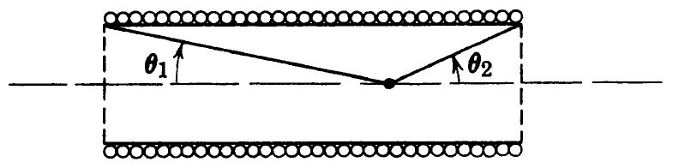
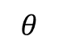
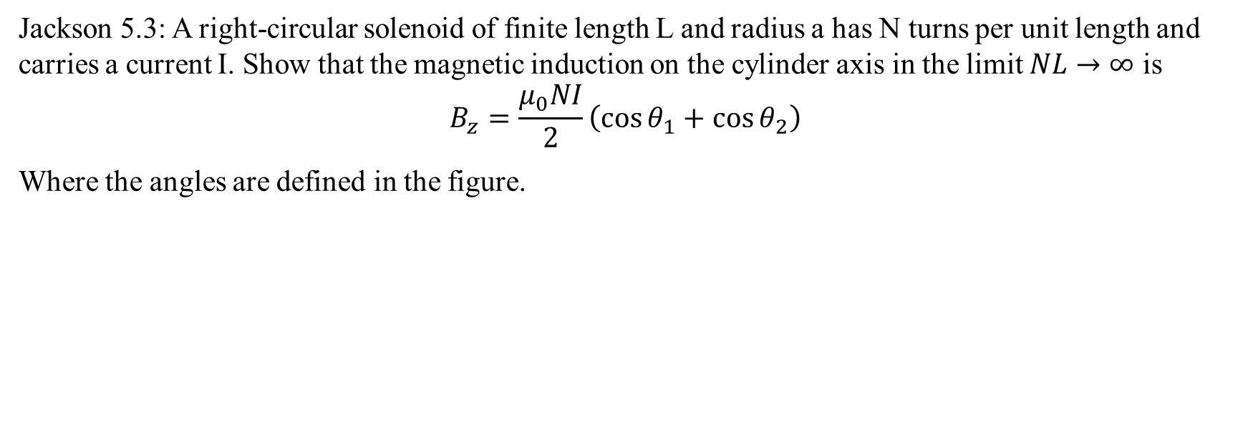
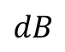
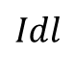
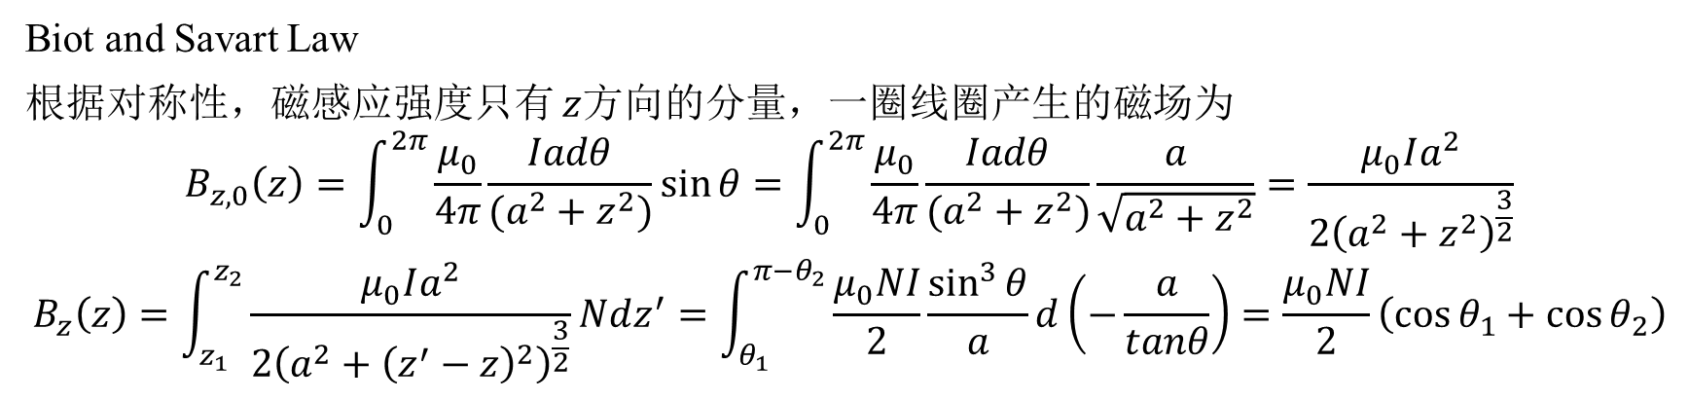
Jackson 5.3: A right-circular solenoid of finite length L and radius a has N turns per unit length and carries a current I. Show that the magnetic induction on the cylinder axis in the limit $NL→∞$ is
$$B_{z}=\frac{μ_{0}NI}{2}\left(\cos{θ_{1}}+\cos{θ_{2}}\right)$$
Where the angles are defined in the figure.
$$Idl$$
a
$$dB$$
$$θ$$
z
Biot and Savart Law
根据对称性，磁感应强度只有 $z$方向的分量，一圈线圈产生的磁场为
$$B_{z,0}\left(z\right)=\int_{0}^{2π}{\frac{μ_{0}}{4π}\frac{Iadθ}{(a^{2}+z^{2})}\sin{θ}}=\int_{0}^{2π}{\frac{μ_{0}}{4π}\frac{Iadθ}{(a^{2}+z^{2})}\frac{a}{\sqrt{a^{2}+z^{2}}}}=\frac{μ_{0}Ia^{2}}{2{\left(a^{2}+z^{2}\right)}^{\frac{3}{2}}}$$
$$B_{z}\left(z\right)=\int_{z_{1}}^{z_{2}}{\frac{μ_{0}Ia^{2}}{2{\left(a^{2}+{\left(z^{′}−z\right)}^{2}\right)}^{\frac{3}{2}}}}Ndz^{′}=\int_{θ_{1}}^{π−θ_{2}}{\frac{μ_{0}NI}{2}\frac{\sin^{3}{θ}}{a}d\left(−\frac{a}{tanθ}\right)}=\frac{μ_{0}NI}{2}\left(\cos{θ_{1}}+\cos{θ_{2}}\right)$$

Slide 3
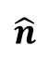
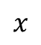
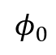
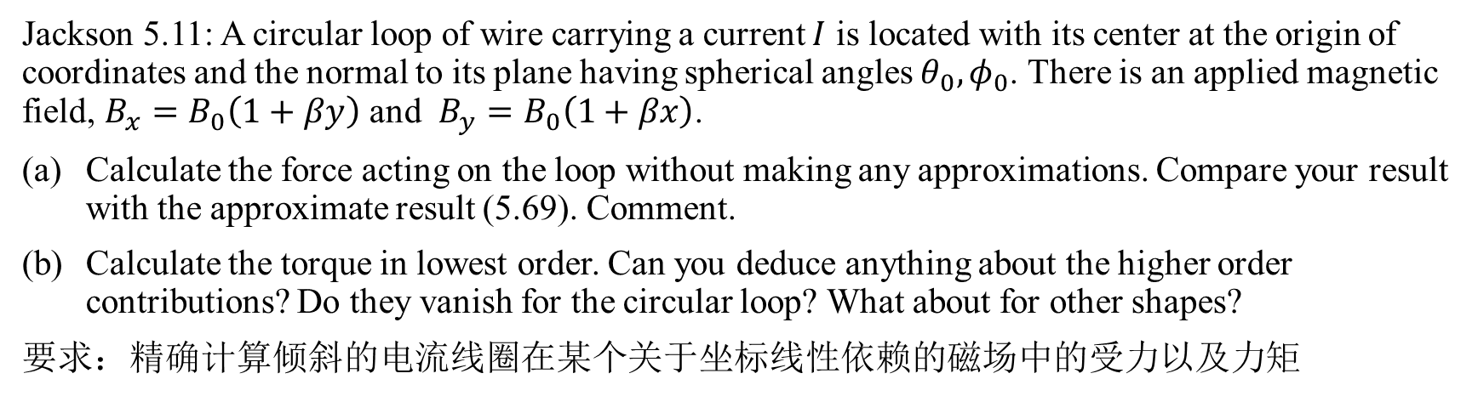
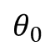
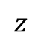
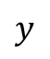
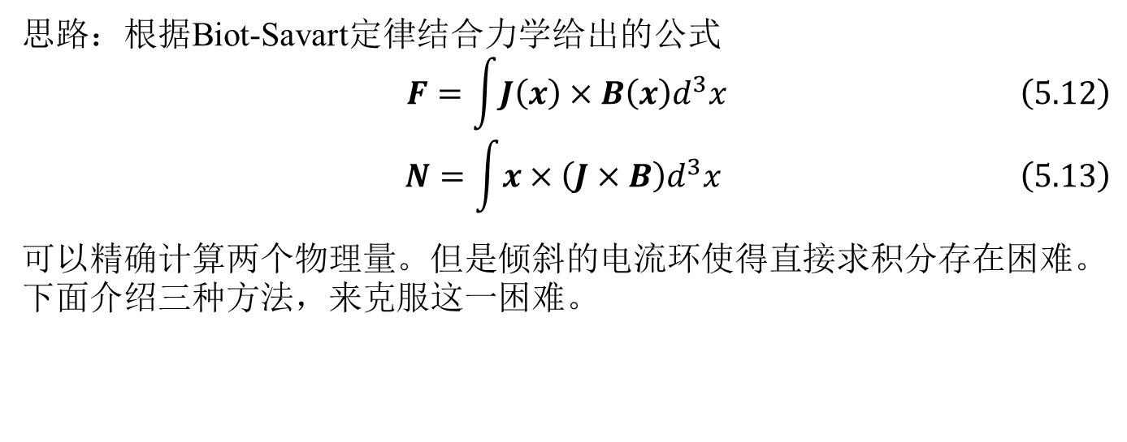
Jackson 5.11: A circular loop of wire carrying a current $I$ is located with its center at the origin of coordinates and the normal to its plane having spherical angles $θ_{0}, φ_{0}$. There is an applied magnetic field, $B_{x}=B_{0}\left(1+βy\right)$ and $B_{y}=B_{0}\left(1+βx\right)$.
Calculate the force acting on the loop without making any approximations. Compare your result with the approximate result (5.69). Comment.
Calculate the torque in lowest order. Can you deduce anything about the higher order contributions? Do they vanish for the circular loop? What about for other shapes?
要求：精确计算倾斜的电流线圈在某个关于坐标线性依赖的磁场中的受力以及力矩
$$z$$
思路：根据Biot-Savart定律结合力学给出的公式
$$\begin{aligned} F=\int{J\left(x\right)×B\left(x\right)d^{3}x}\#\left(5.12\right)\end{aligned}$$
$$\begin{aligned} N=\int{x×\left(J×B\right)d^{3}x} \#\left(5.13\right)\end{aligned}$$
可以精确计算两个物理量。但是倾斜的电流环使得直接求积分存在困难。下面介绍三种方法，来克服这一困难。
$$\hat{n}$$
$$θ_{0}$$
$$y$$
$$φ_{0}$$
$$x$$

Slide 4
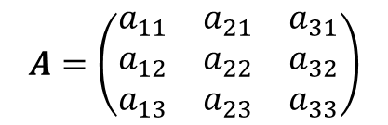
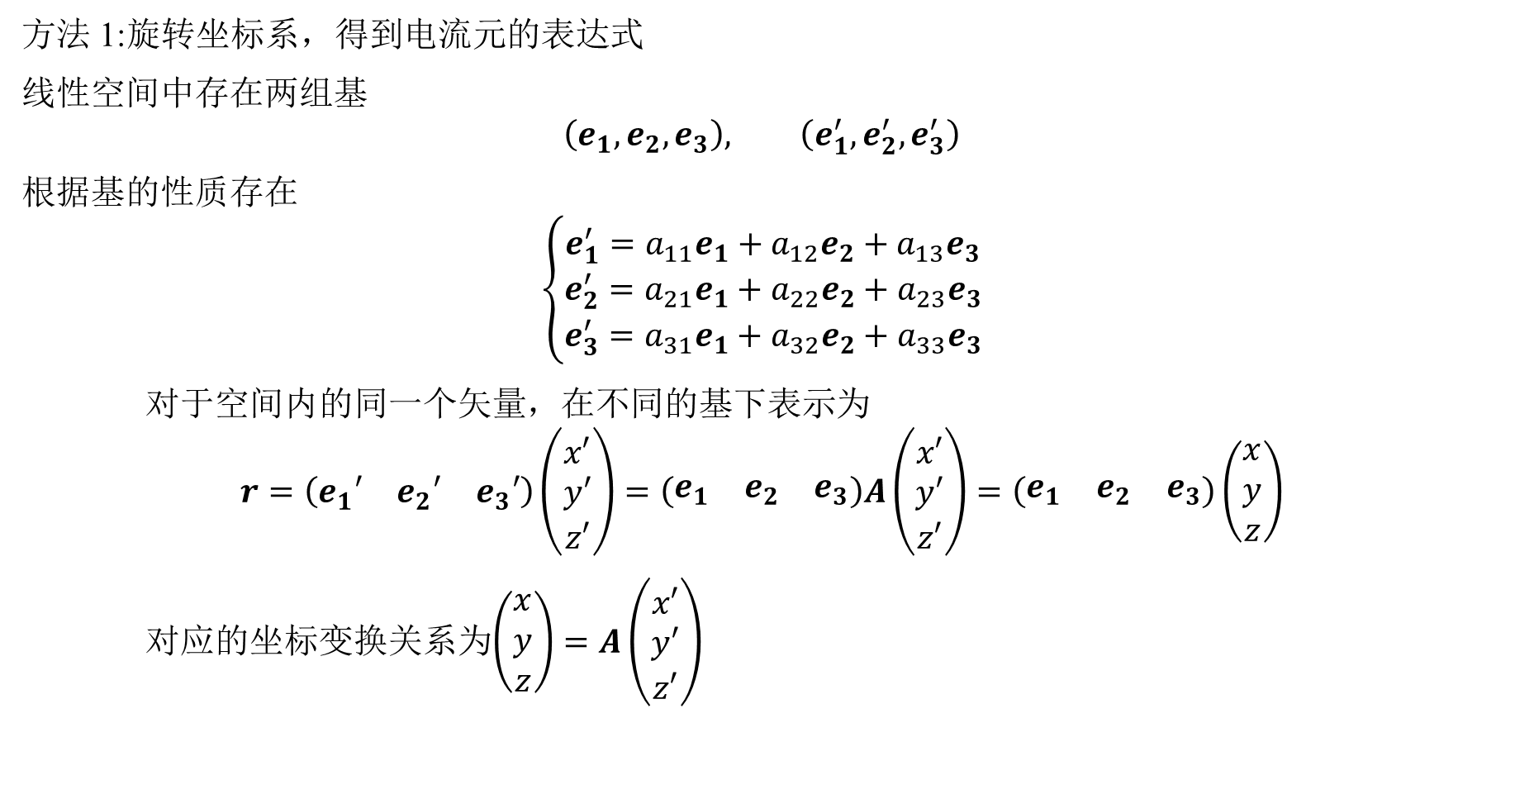
方法 1:旋转坐标系，得到电流元的表达式
线性空间中存在两组基
$$\left(e_{1},e_{2},e_{3}\right), \left(e_{1}^{′},e_{2}^{′},e_{3}^{′}\right)$$
根据基的性质存在
$$\left\{\begin{aligned}e_{1}^{′}=a_{11}e_{1}+a_{12}e_{2}+a_{13}e_{3} \\ e_{2}^{′}=a_{21}e_{1}+a_{22}e_{2}+a_{23}e_{3} \\ e_{3}^{′}=a_{31}e_{1}+a_{32}e_{2}+a_{33}e_{3}\end{aligned}\right.$$
对于空间内的同一个矢量，在不同的基下表示为
$$r=\left(\begin{matrix}e_{1}′ & e_{2}′ & e_{3}′\end{matrix}\right)\left(\begin{matrix}x′ \\ y′ \\ z′\end{matrix}\right)=\left(\begin{matrix}e_{1} & e_{2} & e_{3}\end{matrix}\right)A\left(\begin{matrix}x′ \\ y′ \\ z′\end{matrix}\right)=\left(\begin{matrix}e_{1} & e_{2} & e_{3}\end{matrix}\right)\left(\begin{matrix}x \\ y \\ z\end{matrix}\right)$$
对应的坐标变换关系为$\left(\begin{matrix}x \\ y \\ z\end{matrix}\right)=A\left(\begin{matrix}x′ \\ y′ \\ z′\end{matrix}\right)$
$$A=\left(\begin{matrix}a_{11} & a_{21} & a_{31} \\ a_{12} & a_{22} & a_{32} \\ a_{13} & a_{23} & a_{33}\end{matrix}\right)$$

Slide 5
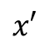
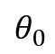
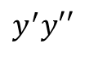
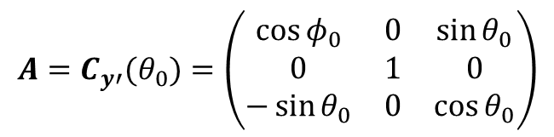
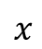
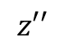
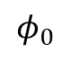
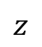
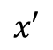
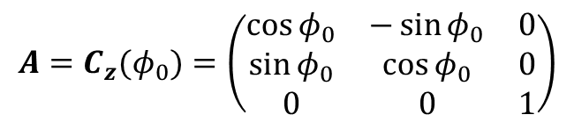
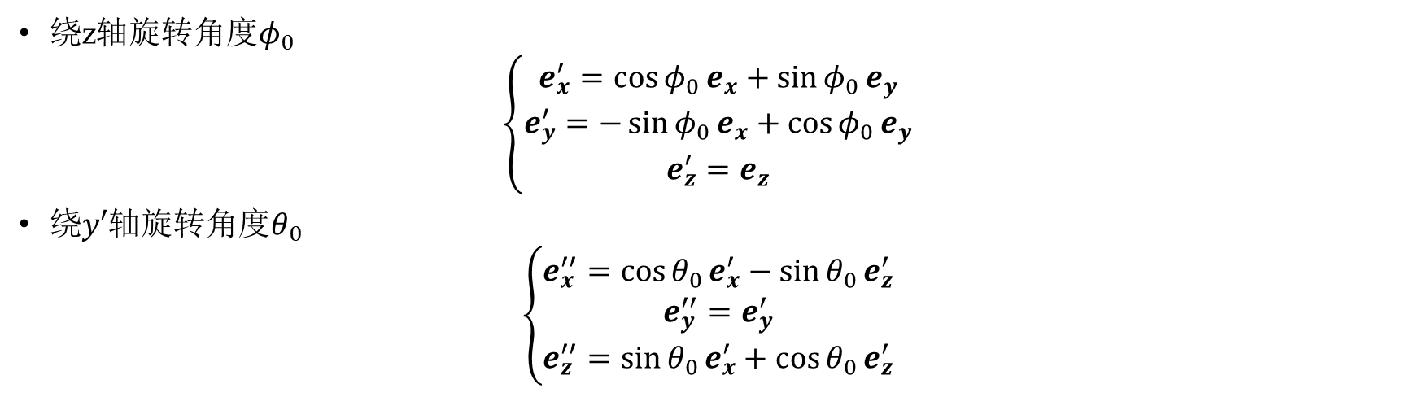
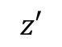
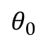
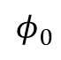
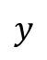
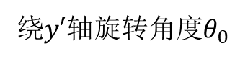
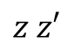
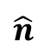
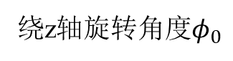
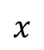
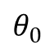
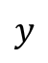
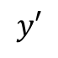
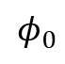
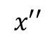
$$z$$
$$z′$$
$$z z′$$
$$z′′$$
$$\hat{n}$$
$$y^{′}y′′$$
$$θ_{0}$$
$$θ_{0}$$
$$y′$$
$$y$$
$$φ_{0}$$
$$y$$
$$φ_{0}$$
$$φ_{0}$$
$$x$$
$$x$$
$$x′$$
$$θ_{0}$$
$$x′$$
绕z轴旋转角度$φ_{0}$
$$x′′$$
绕$y′$轴旋转角度$θ_{0}$
绕z轴旋转角度$φ_{0}$
$$\left\{\begin{aligned}e_{x}^{′}=\cos{φ_{0}}e_{x}+\sin{φ_{0}}e_{y} \\ e_{y}^{′}=−\sin{φ_{0}}e_{x}+\cos{φ_{0}}e_{y} \\ e_{z}^{′}=e_{z}\end{aligned}\right.$$
绕$y′轴$旋转角度$θ_{0}$
$$\left\{\begin{aligned}e_{x}^{′′}=\cos{θ_{0}}e_{x}^{′}−\sin{θ_{0}}e_{z}^{′} \\ e_{y}^{′′}=e_{y}^{′} \\ e_{z}^{′′}=\sin{θ_{0}}e_{x}^{′}+\cos{θ_{0}}e_{z}^{′}\end{aligned}\right.$$
$$A=C_{z}(φ_{0})=\left(\begin{matrix}\cos{φ_{0}} & −\sin{φ_{0}} & 0 \\ \sin{φ_{0}} & \cos{φ_{0}} & 0 \\ 0 & 0 & 1\end{matrix}\right)$$
$$A=C_{y′}(θ_{0})=\left(\begin{matrix}\cos{φ_{0}} & 0 & \sin{θ_{0}} \\ 0 & 1 & 0 \\ −\sin{θ_{0}} & 0 & \cos{θ_{0}}\end{matrix}\right)$$

Slide 6
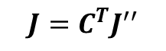
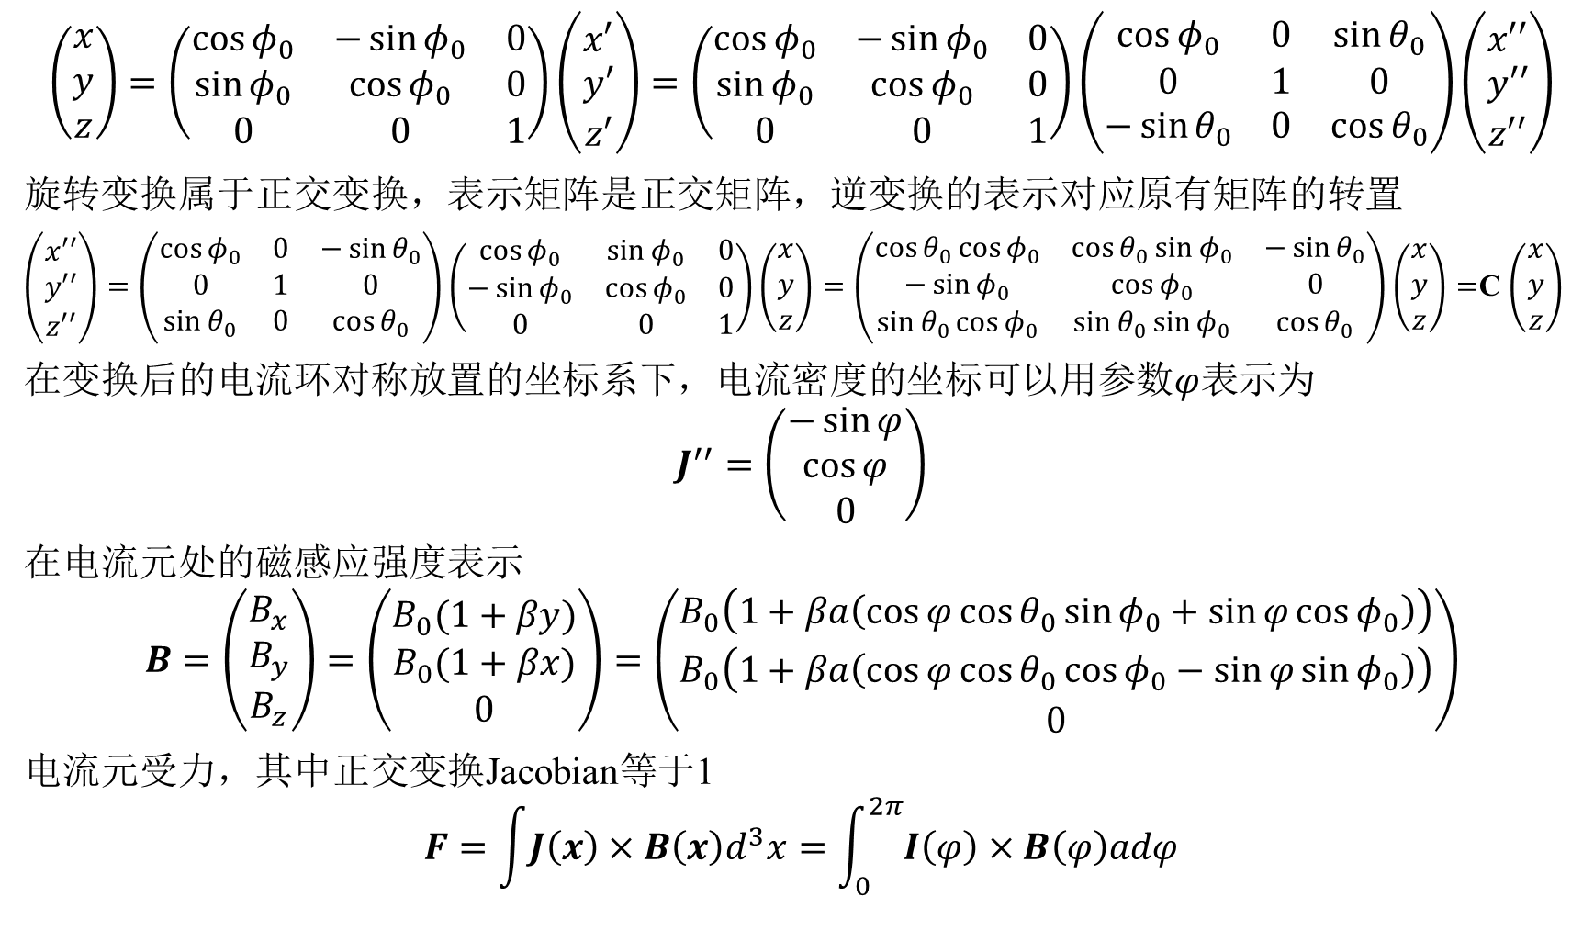
$$\left(\begin{matrix}x \\ y \\ z\end{matrix}\right)=\left(\begin{matrix}\cos{φ_{0}} & −\sin{φ_{0}} & 0 \\ \sin{φ_{0}} & \cos{φ_{0}} & 0 \\ 0 & 0 & 1\end{matrix}\right)\left(\begin{matrix}x′ \\ y′ \\ z′\end{matrix}\right)=\left(\begin{matrix}\cos{φ_{0}} & −\sin{φ_{0}} & 0 \\ \sin{φ_{0}} & \cos{φ_{0}} & 0 \\ 0 & 0 & 1\end{matrix}\right)\left(\begin{matrix}\cos{φ_{0}} & 0 & \sin{θ_{0}} \\ 0 & 1 & 0 \\ −\sin{θ_{0}} & 0 & \cos{θ_{0}}\end{matrix}\right)\left(\begin{matrix}x′′ \\ y′′ \\ z′′\end{matrix}\right)$$
旋转变换属于正交变换，表示矩阵是正交矩阵，逆变换的表示对应原有矩阵的转置
$\left(\begin{matrix}x′′ \\ y′′ \\ z′′\end{matrix}\right)=\left(\begin{matrix}\cos{φ_{0}} & 0 & −\sin{θ_{0}} \\ 0 & 1 & 0 \\ \sin{θ_{0}} & 0 & \cos{θ_{0}}\end{matrix}\right)\left(\begin{matrix}\cos{φ_{0}} & \sin{φ_{0}} & 0 \\ −\sin{φ_{0}} & \cos{φ_{0}} & 0 \\ 0 & 0 & 1\end{matrix}\right)\left(\begin{matrix}x \\ y \\ z\end{matrix}\right)=\left(\begin{matrix}\cos{θ_{0}}\cos{φ_{0}} & \cos{θ_{0}}\sin{φ_{0}} & −\sin{θ_{0}} \\ −\sin{φ_{0}} & \cos{φ_{0}} & 0 \\ \sin{θ_{0}}\cos{φ_{0}} & \sin{θ_{0}}\sin{φ_{0}} & \cos{θ_{0}}\end{matrix}\right)\left(\begin{matrix}x \\ y \\ z\end{matrix}\right)=$C $\left(\begin{matrix}x \\ y \\ z\end{matrix}\right)$
在变换后的电流环对称放置的坐标系下，电流密度的坐标可以用参数$φ$表示为
$$J^{′′}=\left(\begin{matrix}−\sin{φ} \\ \cos{φ} \\ 0\end{matrix}\right)$$
在电流元处的磁感应强度表示
$$B=\left(\begin{matrix}B_{x} \\ B_{y} \\ B_{z}\end{matrix}\right)=\left(\begin{matrix}B_{0}(1+βy) \\ B_{0}(1+βx) \\ 0\end{matrix}\right)=\left(\begin{matrix}B_{0}\left(1+βa\left(\cos{φ}\cos{θ_{0}}\sin{φ_{0}}+\sin{φ}\cos{φ_{0}}\right)\right) \\ B_{0}\left(1+βa\left(\cos{φ}\cos{θ_{0}}\cos{φ_{0}}−\sin{φ}\sin{φ_{0}}\right)\right) \\ 0\end{matrix}\right)$$
电流元受力，其中正交变换Jacobian等于1
$$F=\int{J\left(x\right)×B\left(x\right)d^{3}x}=\int_{0}^{2π}{I\left(φ\right)×B\left(φ\right)adφ}$$
$$J=C^{T}J^{′′}$$

Slide 7
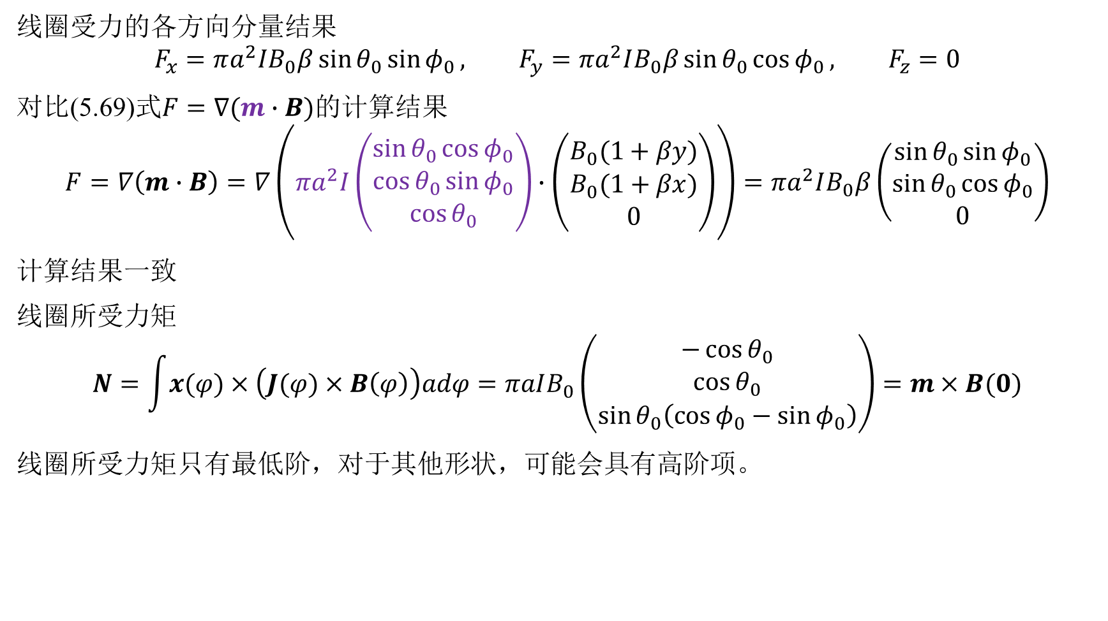
线圈受力的各方向分量结果
$$F_{x}=πa^{2}IB_{0}β\sin{θ_{0}}\sin{φ_{0}}, F_{y}=πa^{2}IB_{0}β\sin{θ_{0}}\cos{φ_{0}}, F_{z}=0$$
对比(5.69)式$F=∇(m∙B)的$计算结果
$$F=∇\left(m∙B\right)=∇\left(πa^{2}I\left(\begin{matrix}\sin{θ_{0}}\cos{φ_{0}} \\ \cos{θ_{0}}\sin{φ_{0}} \\ \cos{θ_{0}}\end{matrix}\right)∙\left(\begin{matrix}B_{0}(1+βy) \\ B_{0}(1+βx) \\ 0\end{matrix}\right)\right)=πa^{2}IB_{0}β\left(\begin{matrix}\sin{θ_{0}}\sin{φ_{0}} \\ \sin{θ_{0}}\cos{φ_{0}} \\ 0\end{matrix}\right)$$
计算结果一致
线圈所受力矩
$$N=\int{x(φ)×\left(J(φ)×B\left(φ\right)\right)adφ}=πaIB_{0}\left(\begin{matrix}−\cos{θ_{0}} \\ \cos{θ_{0}} \\ \sin{θ_{0}\left(\cos{φ_{0}}−\sin{φ_{0}}\right)}\end{matrix}\right)=m×B(0)$$
线圈所受力矩只有最低阶，对于其他形状，可能会具有高阶项。

Slide 8
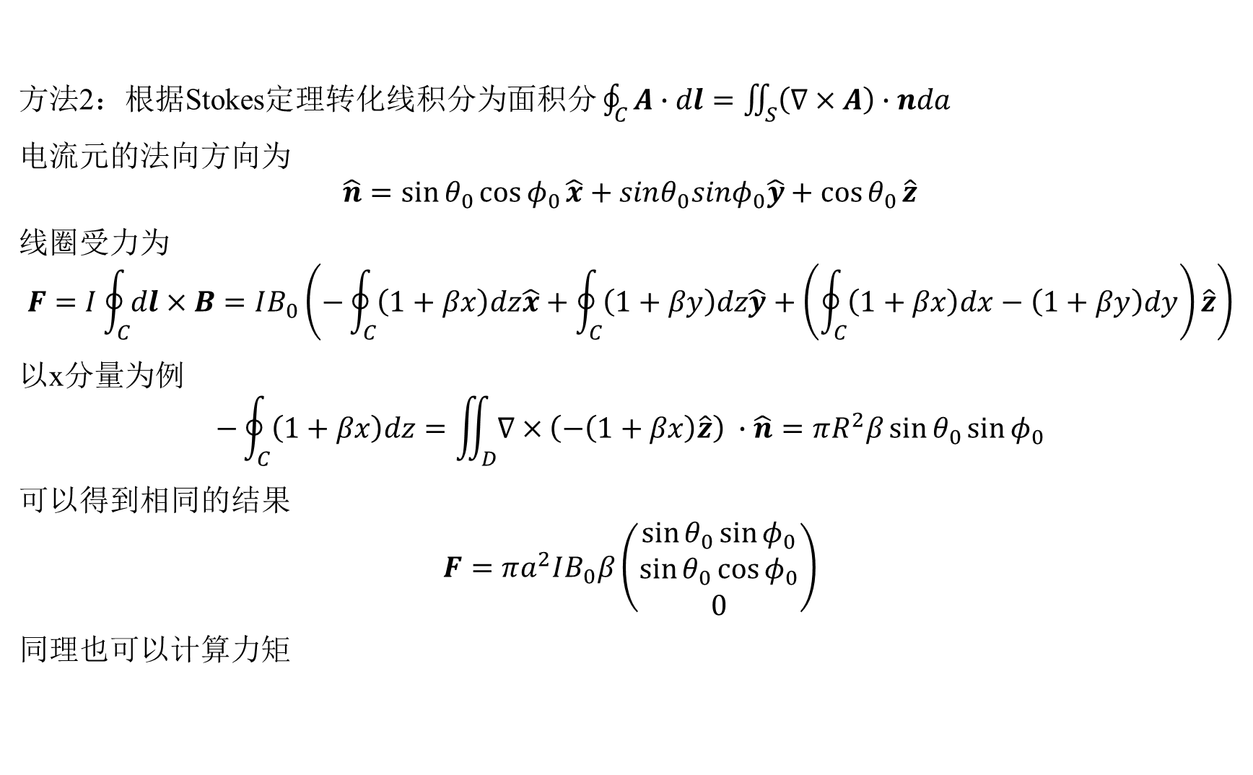
方法2：根据Stokes定理转化线积分为面积分 $\oint_{C}{A∙dl}=\iint_{S}{\left(∇×A\right)∙nda}$
电流元的法向方向为
$$\hat{n}=\sin{θ_{0}}\cos{φ_{0}}\hat{x}+sinθ_{0}sinφ_{0}\hat{y}+\cos{θ_{0}}\hat{z}$$
线圈受力为
$$F=I\oint_{C}{dl×B}=IB_{0}\left(−\oint_{C}{\left(1+βx\right)dz\hat{x}}+\oint_{C}{\left(1+βy\right)dz\hat{y}}+\left(\oint_{C}{\left(1+βx\right)dx}−\left(1+βy\right)dy\right)\hat{z}\right)$$
以x分量为例
$$−\oint_{C}{\left(1+βx\right)dz}=\iint_{D}{∇×\left(−\left(1+βx\right)\hat{z}\right) }∙\hat{n}=πR^{2}β\sin{θ_{0}}\sin{φ_{0}}$$
可以得到相同的结果
$$F=πa^{2}IB_{0}β\left(\begin{matrix}\sin{θ_{0}}\sin{φ_{0}} \\ \sin{θ_{0}}\cos{φ_{0}} \\ 0\end{matrix}\right)$$
同理也可以计算力矩

Slide 9
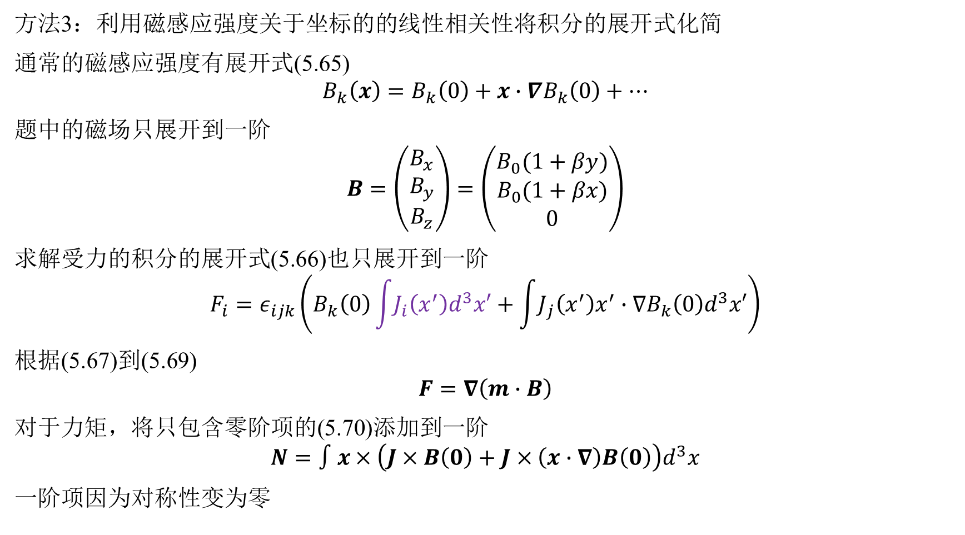
方法3：利用磁感应强度关于坐标的的线性相关性将积分的展开式化简
通常的磁感应强度有展开式(5.65)
$$B_{k}\left(x\right)=B_{k}\left(0\right)+x∙∇B_{k}\left(0\right)+…$$
题中的磁场只展开到一阶
$$B=\left(\begin{matrix}B_{x} \\ B_{y} \\ B_{z}\end{matrix}\right)=\left(\begin{matrix}B_{0}(1+βy) \\ B_{0}(1+βx) \\ 0\end{matrix}\right)$$
求解受力的积分的展开式(5.66)也只展开到一阶
$$F_{i}=ε_{ijk}\left(B_{k}\left(0\right)\int{J_{i}\left(x^{′}\right)d^{3}x′}+\int{J_{j}\left(x^{′}\right)x^{′}∙∇B_{k}\left(0\right)d^{3}x′}\right)$$
根据(5.67)到(5.69)
$$F=∇\left(m∙B\right)$$
对于力矩，将只包含零阶项的(5.70)添加到一阶
$$N=∫x×\left(J×B\left(0\right)+J×\left(x∙∇\right)B\left(0\right)\right)d^{3}x$$
一阶项因为对称性变为零

Slide 10
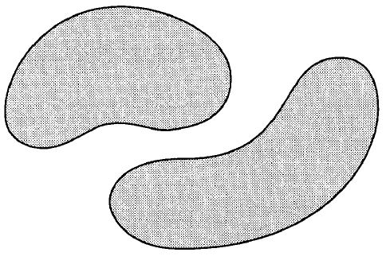
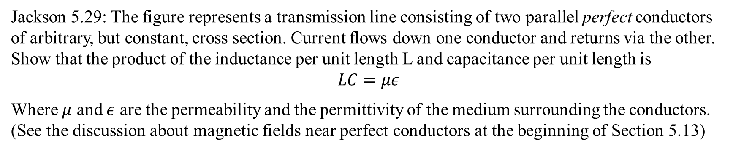
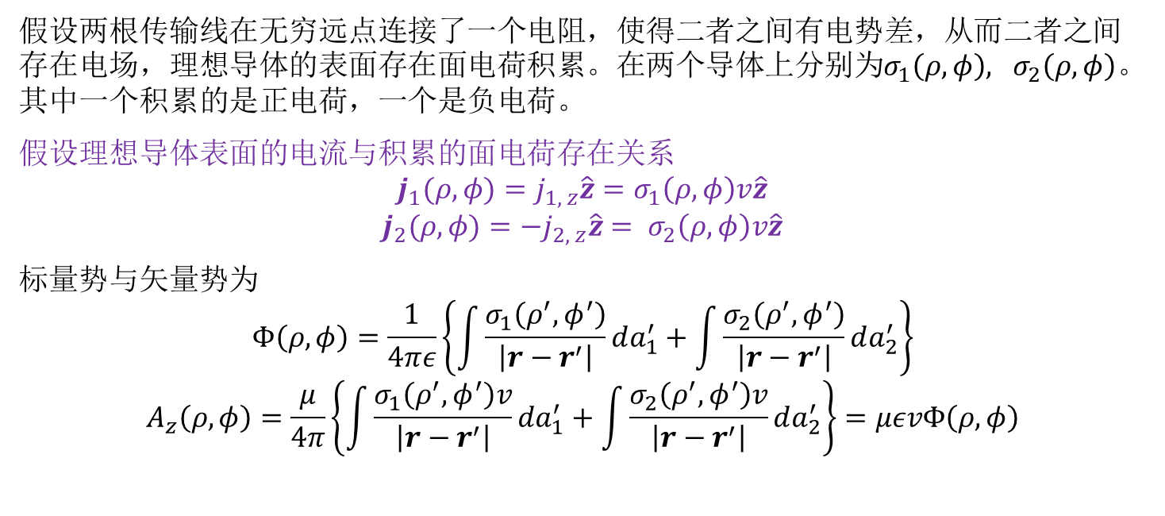
Jackson 5.29: The figure represents a transmission line consisting of two parallel perfect conductors of arbitrary, but constant, cross section. Current flows down one conductor and returns via the other. Show that the product of the inductance per unit length L and capacitance per unit length is
$$LC=με$$
Where $μ$ and $ε$ are the permeability and the permittivity of the medium surrounding the conductors. (See the discussion about magnetic fields near perfect conductors at the beginning of Section 5.13)
假设两根传输线在无穷远点连接了一个电阻，使得二者之间有电势差，从而二者之间存在电场，理想导体的表面存在面电荷积累。在两个导体上分别为$σ_{1}\left(ρ,φ\right), σ_{2}\left(ρ, φ\right)$。其中一个积累的是正电荷，一个是负电荷。
假设理想导体表面的电流与积累的面电荷存在关系
$$j_{1}(ρ,φ)=j_{1, z}\hat{z}=σ_{1}\left(ρ,φ\right)v\hat{z}$$
$$j_{2}(ρ,φ)={−j}_{2, z}\hat{z}= σ_{2}\left(ρ,φ\right)v\hat{z}$$
标量势与矢量势为
$$Φ\left(ρ,φ\right)=\frac{1}{4πε}\left\{\int{\frac{σ_{1}\left(ρ^{′},φ^{′}\right)}{\left|r−r^{′}\right|}da_{1}^{′}}+\int{\frac{σ_{2}\left(ρ^{′},φ^{′}\right)}{\left|r−r^{′}\right|}da_{2}^{′}}\right\}$$
$$A_{z}\left(ρ,φ\right)=\frac{μ}{4π}\left\{\int{\frac{σ_{1}\left(ρ^{′},φ^{′}\right)v}{\left|r−r^{′}\right|}da_{1}^{′}}+\int{\frac{σ_{2}\left(ρ^{′},φ^{′}\right)v}{\left|r−r^{′}\right|}da_{2}^{′}}\right\}=μεvΦ\left(ρ,φ\right)$$

Slide 11
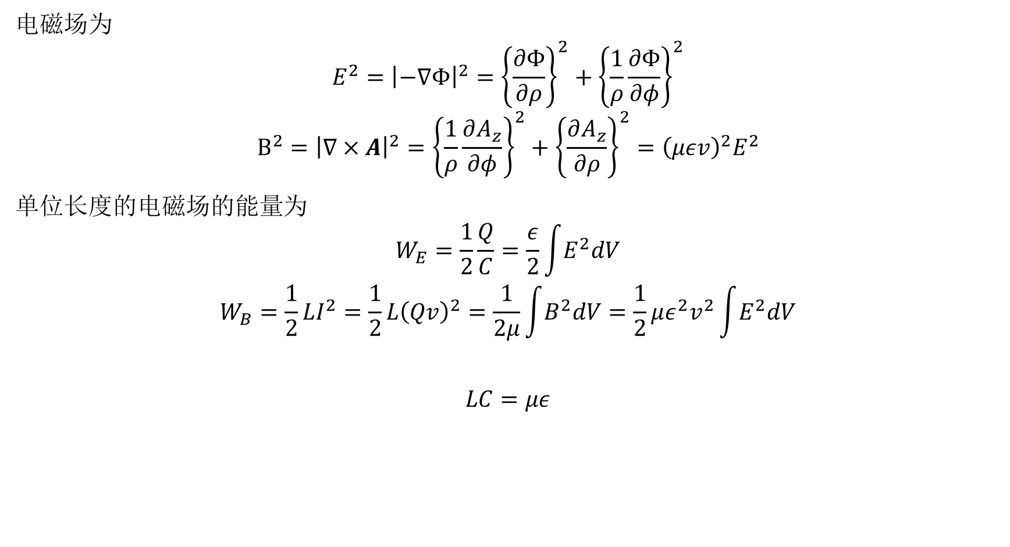
电磁场为
$$E^{2}={\left|−∇Φ\right|}^{2}={\left\{\frac{∂Φ}{∂ρ}\right\}}^{2}+{\left\{\frac{1}{ρ}\frac{∂Φ}{∂φ}\right\}}^{2}$$
$$B^{2}={\left|∇×A\right|}^{2}={\left\{\frac{1}{ρ}\frac{∂A_{z}}{∂φ}\right\}}^{2}+{\left\{\frac{∂A_{z}}{∂ρ}\right\}}^{2}={\left(μεv\right)}^{2}E^{2}$$
单位长度的电磁场的能量为
$$W_{E}=\frac{1}{2}\frac{Q}{C}=\frac{ε}{2}\int{E^{2}dV}$$
$$W_{B}=\frac{1}{2}LI^{2}=\frac{1}{2}L{\left(Qv\right)}^{2}=\frac{1}{2μ}\int{B^{2}dV}=\frac{1}{2}με^{2}v^{2}\int{E^{2}dV}$$
$$LC=με$$

Slide 12

Jackson 6.1: In three dimensions the solution to the wave equation (6.32) for a point source in space and time (a light flash at $t^{′}=0, x^{′}=0$) is a spherical shell disturbance of radius $R=ct$，namely the Green function $G^{+}$ (6.44). It may be initially surprising that in one or two dimensions, the disturbance possesses a “wake”, even though the source is a “point” in space and time. The solution for fewer dimensions than three can be found by superposition in the superfluous dimension(s), to eliminate dependence on such variable(s). For example, a flashing line source of uniform amplitude is equivalent to a point source in two dimensions.
Starting with the retarded solution to the three-dimensional wave equation (6.47), show that the source $f\left(x^{′},t\right)=δ\left(x^{′}\right)δ\left(y^{′}\right)δ\left(t^{′}\right)$, equivalent to a $t=0$ point source at the origin in two dimensions, produce a two-dimensional wave,
$$Ψ\left(x, y, t\right)=\frac{2cΘ\left(ct−ρ\right)}{\sqrt{c^{2}t^{2}−ρ^{2}}}$$
Where $ρ^{2}=x^{2}+y^{2}$ and $Θ\left(ξ\right)$ is the unit step function.
Show that a “sheet” source, equivalent to a point pulsed source at the origin in one space dimension, produces a one-dimensional wave proportional to
$$Ψ\left(x,t\right)=2πcΘ\left(ct−\left|x\right|\right)$$
使用推迟Green函数和低维冲激函数计算低维的响应函数

Slide 13

方程(6.32)
$$∇^{2}Ψ−\frac{1}{c^{2}}\frac{∂^{2}Ψ}{∂t^{2}}=−4πf(x,t)$$
的Green函数满足非齐次方程(6.36)
$$\left(∇^{2}+k^{2}\right)G_{k}\left(x,x^{′}\right)=−4πδ(x−x′)$$
Green函数形式为
$$G^{\left(±\right)}\left(x, t;x^{′},t^{′}\right)=\frac{δ\left(t^{′}−(t∓\frac{\left|x−x^{′}\right|}{c})\right)}{\left|x−x^{′}\right|}$$
方程(6.32)最符合物理情况的解的形式为(6.47)式
$$Ψ\left(x,t\right)=\iint{G^{\left(+\right)}\left(x, t;x^{′},t^{′}\right)f\left(x^{′},t^{′}\right)d^{3}x^{′}dt^{′}}=\int{\frac{{\left[f\left(x^{′},t^{′}\right)\right]}_{ret}}{\left|x−x′\right|}d^{3}x′}$$
(a)问结果为
$$Ψ\left(x,t\right)=\int{\frac{{\left[f\left(x^{′},t^{′}\right)\right]}_{ret}}{\left|x−x′\right|}d^{3}x′}=\int{\frac{δ\left(x^{′}\right)δ\left(y^{′}\right)δ\left(t−\frac{\left|x−x^{′}\right|}{c}\right)}{\left|x−x^{′}\right|}dx^{′}dy^{′}dz′}$$

Slide 14

$$Ψ\left(x,t\right)=\int{\frac{δ\left(x^{′}\right)δ\left(y^{′}\right)δ\left(t−\frac{\left|x−x^{′}\right|}{c}\right)}{\left|x−x^{′}\right|}dx^{′}dy^{′}dz′}=\int_{−∞}^{∞}{\frac{δ\left(t−\frac{\sqrt{ρ^{2}+{\left(z−z^{′}\right)}^{2}}}{c}\right)}{\sqrt{ρ^{2}+{\left(z−z^{′}\right)}^{2}}}dz′}$$
$δ$函数具有性质
$$δ\left(f\left(z\right)\right)=\sum_{i}{\frac{δ\left(z−z_{i}\right)}{\left|f^{′}\left(z_{i}\right)\right|}}, ρ^{2}+{\left(z−z_{i}^{′}\right)}^{2}=c^{2}t^{2}$$
所以
$$δ\left(t−\frac{\sqrt{ρ^{2}+{\left(z−z^{′}\right)}^{2}}}{c}\right)=\sum_{i}{\frac{1}{\left|\frac{z^{′}−z}{c\sqrt{ρ^{2}+{\left(z−z^{′}\right)}^{2}}}\right|}δ(z−z_{i}^{′})}$$
当$ρ<ct时$，有两个零点 $z_{i}^{′}=z±\sqrt{c^{2}t^{2}−ρ^{2}}$
当$ρ=ct时$，有一个零点 $z_{i}^{′}=z$
当$ρ>ct时$，没有零点
$$Ψ\left(x,t\right)=\int_{−∞}^{∞}{\sum_{i}{\frac{c}{|z_{i}^{′}−z|}}dz′}=\frac{2cΘ\left(ct−ρ\right)}{\sqrt{c^{2}t^{2}−ρ^{2}}}$$
(b)问同理可得

Slide 15

Griffiths 10.9: (1) Suppose one infinite straight wire carries a linearly increasing current: $I\left(t\right)=kt$ for $t>0$. Find the electric and magnetic fields generated.
(2) Do the same for the case of a sudden burst of current:$I\left(t\right)=q_{0}δ\left(t\right)$
根据书中(6.48)式可以计算标量势与矢量势的推迟解
$$Φ\left(x,t\right)=\frac{1}{4πε_{0}}\int{d^{3}x^{′}\frac{1}{R}{\left[ρ\left(x^{′},t\right)\right]}_{ret}}$$
$$A\left(x,t\right)=\frac{μ_{0}}{4π}\int{d^{3}x^{′}\frac{1}{R}{\left[J\left(x^{′},t\right)\right]}_{ret}}$$
进一步可以计算电磁场
$$E=−∇Φ−\frac{∂}{∂t}A$$
$$B=∇×A$$
题目中只有电流密度，没有电荷密度，故只有矢量势
也可以根据(6.55)和(6.56)式计算
$$E\left(x,t\right)=\frac{1}{4πε_{0}}\int{d^{3}x^{′}\left\{\frac{\hat{R}}{R^{2}}{\left[ρ(x^{′},t′)\right]}_{ret}+\frac{\hat{R}}{cR}{\left[\frac{∂ρ\left(x^{′},t^{′}\right)}{∂t^{′}}\right]}_{ret}−\frac{1}{c^{2}R}{\left[\frac{∂J\left(x^{′},t\right)}{∂t^{′}}\right]}_{ret}\right\}}$$
$$B\left(x,t\right)=\frac{μ_{0}}{4π}\int{d^{3}x^{′}}\left\{{\left[J\left(x^{′},t^{′}\right)\right]}_{ret}×\frac{\hat{R}}{R^{2}}+{\left[\frac{∂J\left(x^{′},t^{′}\right)}{∂t^{′}}\right]}_{ret}×\frac{\hat{R}}{cR}\right\}$$

Slide 16

第一问， $t>\frac{ρ}{c}$的区间才存在场
$$A_{z}\left(ρ,t\right)=\frac{μ_{0}k}{2π}\int_{0}^{\sqrt{c^{2}t^{2}−ρ^{2}}}{\frac{t−\frac{\sqrt{ρ^{2}+z^{2}}}{c}}{\sqrt{ρ^{2}+z^{2}}}dz}=−\frac{μ_{0}k}{2π}\left(t\ln\left(\frac{ct}{ρ}+\sqrt{{\left(\frac{ct}{ρ}\right)}^{2}−1}\right)−\frac{ρ}{c}\sqrt{{\left(\frac{ct}{ρ}\right)}^{2}−1}\right)$$
$$E_{z}\left(ρ,t\right)=−\frac{∂A_{z}}{∂t}=−\frac{μ_{0}k}{2π}\ln\left(\frac{ct}{ρ}+\sqrt{{\left(\frac{ct}{ρ}\right)}^{2}−1}\right)$$
$$B_{φ}\left(ρ,t\right)=\left(∇×A\right)∙\hat{φ}=−\frac{∂A_{z}}{∂ρ}=\frac{μ_{0}k}{2πc}\sqrt{{\left(\frac{ct}{ρ}\right)}^{2}−1}$$
第二问
$$A_{z}\left(ρ,t\right)=\frac{μ_{0}q_{0}}{4π}\int_{−∞}^{∞}{\frac{δ\left(t−\frac{\sqrt{ρ^{2}+z^{2}}}{c}\right)}{\sqrt{ρ^{2}+z^{2}}}dz}=\frac{μ_{0}q_{0}cΘ\left(ct−ρ\right)}{2π\sqrt{c^{2}t^{2}−ρ^{2}}}$$
$$E_{z}\left(ρ,t\right)=\frac{μ_{0}q_{0}c^{3}t}{2π{\left(c^{2}t^{2}−ρ^{2}\right)}^{\frac{3}{2}}}$$
$$B_{φ}\left(ρ,t\right)=\frac{μ_{0}q_{0}cρ}{2π{\left(c^{2}t^{2}−ρ^{2}\right)}^{\frac{3}{2}}}$$
或者可以写成阶跃函数的形式

Slide 17



Jackson 6.13: A parallel plate capacitor is formed of two flat rectangular perfectly conducting sheets of dimensions $a$ and b separated by a distance d small compared to a or b. Current is fed in and taken out uniformly along the adjacent edges of length b. With the input current and voltage defined at this end of the capacitor, calculate the input impedance or admittance using the field concepts of Section 6.9.
Calculate the electric and magnetic fields in the capacitor correct to second order in powers of the frequency, but neglecting fringing fields.
Show that the expansion of the reactance(6.140) in powers of the frequency to an appropriate order is the same as that obtained for a lumped circuit consisting of a capacitance $C=ε_{0}ab/d$ in series with an inductance $L=μ_{0}ad/3b$
z
电流从上下两个平板的相邻的长度为$b$的边流入和流出。设总电流大小为$I(t)$，面电流密度$κ\left(x,y,z,t\right)$满足
$$κ\left(a, y, 0, t\right)=−κ\left(a, y, d, t\right)=\frac{I\left(t\right)}{b}\hat{x} (0<y<b)$$
$$κ\left(0, y, 0, t\right)=−κ\left(0, y, d, t\right)=0 (0<y<b)$$
d
y
a
b
$$κ$$
x

Slide 18

忽略边缘场，即认为$d≪a,d≪b$。根据对称性认为电场只有$z$方向的分量，磁场只有$y$方向的分量(磁场可以通过Biot-Savart定律确定方向)。因为$y$方向的流入的电流是均匀的，我们认为电磁场只和坐标x有关。
$$E\left(x, y, z, t\right)=E_{z}\left(x,t\right) \hat{z}$$
$$B\left(x,y,z,t\right)=B_{y}\left(x,t\right)\hat{y}$$
在待求解区域中，也即平板中间的区域，因为没有电荷和电流，其电磁场满足的方程为书中式(6.49)和(6.50)
$$∇^{2}E−\frac{1}{c^{2}}\frac{∂^{2}E}{∂t^{2}}= 0$$
$$∇^{2}B−\frac{1}{c^{2}}\frac{∂^{2}B}{∂t^{2}}= 0$$
傅里叶变换后的方程为
$$\frac{d^{2}E_{z}}{dx^{2}}+\frac{ω^{2}}{c^{2}}E_{z}=0$$
$$\frac{d^{2}B_{y}}{dx^{2}}+\frac{ω^{2}}{c^{2}}B_{y}=0$$
得到的解为
$$E_{z}=A\cos\left(\left(\frac{ω}{c}\right)x+φ\right)$$
$$B_{y}=B\cos\left(\left(\frac{ω}{c}\right)x+ψ\right)$$

Slide 19





Maxwell方程给出Helmholtz没有给出的约束
$$\frac{∂E_{z}}{∂x}+iωB_{y}=0$$
结合边界条件
$$E_{z}(x,ω)=\frac{\tilde{σ}(x,ω)}{ε_{0}}$$
$$B_{y}(x,ω)={−μ}_{0}\tilde{κ}(x,ω)$$
得到最终结果
$$E_{z}\left(x,ω\right)=−\frac{\tilde{I}\left(ω\right)μ_{0}ic}{b\sin\left(\left(\frac{ω}{c}\right)a\right)}\cos\left(\left(\frac{ω}{c}\right)x\right)$$
$$B_{y}\left(x,ω\right)=−\frac{\tilde{I}\left(ω\right)μ_{0}}{b\sin\left(\left(\frac{ω}{c}\right)a\right)}\sin\left(\left(\frac{ω}{c}\right)x\right)$$
级数展开结果
$$E_{z}\left(x,ω\right)= −\frac{\tilde{I}\left(ω\right)μ_{0}ic}{b}\left(\frac{c}{aω}+\left(\frac{x^{2}}{2ac}−\frac{a}{6c}\right)ω+O(ω^{3})\right)$$
$$B_{y}\left(x, ω\right)=−\frac{\tilde{I}\left(ω\right)μ_{0}}{b}\left(\frac{x}{a}+\frac{1}{6}\left(\frac{xa}{c^{2}}−\frac{x^{3}}{ac^{2}}\right)ω^{2}+O\left(ω^{4}\right)\right)$$
$$\tilde{κ}\left(a,ω\right)=\frac{ℱ\left[I\left(t\right)\right]}{b}=\frac{\tilde{I}(ω)}{b}$$
$$\tilde{κ}\left(0, ω\right)=0$$
$$\left(\frac{a}{c}\right)\frac{1}{ω}+…$$
$$\left(\frac{a}{c}\right)ω−\frac{1}{6}{\left(\frac{a}{c}\right)}^{3}ω^{3}+…$$
$$1−\frac{1}{2}{\left(\frac{x}{c}\right)}^{2}ω^{2}+…$$

Slide 20

书中(6.140)给出电抗
$$X≅\frac{4ω}{{\left|\tilde{I}\left(ω\right)\right|}^{2}}\int_{V}{\left(w_{m}−w_{e}\right)d^{3}x}$$
$$w_{e}=\frac{1}{4}ε_{0}{\left|E\right|}^{2}=\frac{ε_{0}}{4}\frac{{\left|\tilde{I}\left(ω\right)\right|}^{2}μ_{0}^{2}c^{2}}{b^{2}}\left(\frac{c^{2}}{a^{2}ω^{2}}+2\left(\frac{x^{2}}{2ac}−\frac{a}{6c}\right)\left(\frac{c}{a}\right)+O\left(ω^{2}\right)\right)≈\frac{ε_{0}}{4}\frac{{\left|\tilde{I}\left(ω\right)\right|}^{2}μ_{0}^{2}c^{2}}{b^{2}}\frac{c^{2}}{a^{2}ω^{2}}=\frac{{\left|\tilde{I}\left(ω\right)\right|}^{2}}{4b^{2}a^{2}ω^{2}ε_{0}}$$
$$w_{m}=\frac{1}{4μ_{0}}{\left|B\right|}^{2}=\frac{1}{4μ_{0}}\frac{{\left|\tilde{I}\left(ω\right)\right|}^{2}μ_{0}^{2}}{b^{2}}\left({\left(\frac{x}{a}\right)}^{2}+\frac{1}{3}\left(\frac{x}{a}\right)\left(\frac{xa}{c^{2}}−\frac{x^{3}}{ac^{2}}\right)ω^{2}+O(ω^{4})\right)≈\frac{1}{4μ_{0}}\frac{{\left|\tilde{I}\left(ω\right)\right|}^{2}μ_{0}^{2}}{b^{2}}{\left(\frac{x}{a}\right)}^{2}=\frac{{\left|\tilde{I}\left(ω\right)\right|}^{2}μ_{0}}{4b^{2}}{\left(\frac{x}{a}\right)}^{2}$$
计算体积分
$$\int_{V}{w_{e}d^{3}x}=\frac{{\left|\tilde{I}\left(ω\right)\right|}^{2}}{4b^{2}a^{2}ω^{2}ε_{0}}abd=\frac{{\left|\tilde{I}\left(ω\right)\right|}^{2}d}{4abω^{2}ε_{0}}$$
$$\int_{V}{w_{m}d^{3}x}=db\int_{0}^{a}{\frac{{\left|\tilde{I}\left(ω\right)\right|}^{2}μ_{0}}{4b^{2}}{\left(\frac{x}{a}\right)}^{2}dx}=\frac{{\left|\tilde{I}\left(ω\right)\right|}^{2}adμ_{0}}{12b}$$
根据(6.140)下面的阐述，电感和电容就有了对应
$$X≅\frac{4ω}{{\left|\tilde{I}\left(ω\right)\right|}^{2}}\left(\frac{{\left|\tilde{I}\left(ω\right)\right|}^{2}adμ_{0}}{12b}−\frac{{\left|\tilde{I}\left(ω\right)\right|}^{2}d}{4abω^{2}ε_{0}}\right)=\frac{adμ_{0}}{3b}ω−\frac{d}{abε_{0}}\frac{1}{ω}=ωL−\frac{1}{ωC}$$

Slide 21


另一种方法，以外加电压作为初始条件，由电生磁磁生电的循环计算电磁场，将傅里叶变换后的电磁场按频率展开
$$E_{z}\left(x,ω\right)=E_{0}+E_{1}ω+E_{2}ω^{2}+E_{3}ω^{3}+…$$
$$B_{y}\left(x,ω\right)=B_{0}+B_{1}ω+B_{2}ω^{2}+B_{3}ω^{3}+…$$
带入Maxwell方程得到
$$\frac{∂}{∂x}\left(E_{0}+E_{1}ω+E_{2}ω^{2}+E_{3}ω^{3}+…\right)=−iω{(B}_{0}+B_{1}ω+B_{2}ω^{2}+B_{3}ω^{3}+…)$$
$$\frac{∂}{∂x}(B_{0}+B_{1}ω+B_{2}ω^{2}+B_{3}ω^{3}+…)=−\frac{iω}{c^{2}}\left(E_{0}+E_{1}ω+E_{2}ω^{2}+E_{3}ω^{3}+…\right)$$
因为频率等于零时，问题为静电磁问题，所以零阶项满足
$$E_{0}=\frac{\tilde{V}\left(0\right)}{d},B_{0}=0$$
得到各阶的递推关系，递推关系是微分方程，求解得到
$$\frac{∂E_{1}}{∂x}=−iB_{0}→E_{1}=A_{1}$$
$$\frac{∂B_{1}}{∂x}=−\frac{i}{c^{2}}E_{0}→B_{1}=−\frac{i}{c^{2}}\frac{\tilde{V}\left(0\right)}{d}x+C_{1}$$
$$\frac{∂E_{2}}{∂x}=−iB_{1}→E_{2}=−9\frac{1}{2}\frac{1}{c^{2}}\frac{\tilde{V}\left(0\right)}{d}x^{2}−iC_{1}x+A_{2}$$
$$\frac{∂B_{2}}{∂x}=−\frac{i}{c^{2}}E_{1}→B_{2}=−\frac{i}{c^{2}}A_{1}x+C_{2}$$
$$\frac{∂B_{3}}{∂x}=−\frac{i}{c^{2}}E_{2}→B_{3}=\frac{1}{6}\frac{i}{c^{4}}\frac{\tilde{V}\left(0\right)}{d}x^{3}−\frac{C_{1}}{2c^{2}}x^{2}−\frac{i}{c^{2}}A_{2}x+C_{3}$$
Maxwell方程
$$−\frac{∂E_{z}}{∂x}=iωB_{y},\frac{∂B_{y}}{∂x}=−\frac{iω}{c^{2}}E_{z}$$

Slide 22

根据边界条件确定积分常数，最终整理得到
$$E_{z}\left(x,ω\right)=\frac{\tilde{V}\left(0\right)}{d}+A_{1}ω+\left(−\frac{1}{2}\frac{1}{c^{2}}\frac{\tilde{V}\left(0\right)}{d}x^{2}+A_{2}\right)ω^{2}+…$$
$$B_{y}\left(x,ω\right)=\left(−\frac{i}{c^{2}}\frac{\tilde{V}\left(0\right)}{d}x\right)ω+\left(−\frac{i}{c^{2}}A_{1}x\right)ω^{2}+\left(\frac{1}{6}\frac{i}{c^{4}}\frac{\tilde{V}\left(0\right)}{d}x^{3}−\frac{i}{c^{2}}A_{2}x\right)ω^{3}+…$$
使用理想导体的条件，平板上面等势，两个板之间的电压差是$\tilde{V}\left(ω\right)$，$E_{z}\left(x,ω\right)$不与$z$相关，因此
$$\tilde{V}\left(ω\right)=\int_{0}^{d}{E_{z}dz}=E_{z}d=\tilde{V}\left(0\right)+dA_{1}ω+d\left(−\frac{1}{2}\frac{1}{c^{2}}\frac{\tilde{V}\left(0\right)}{d}x^{2}+A_{2}\right)ω^{2}+…$$
根据电压关于$ω$的展开式，可以确定$A_{1}$和$A_{2}$。
大家的问题
积分常数直接去掉，并没有合适的理由
认为初始的静电状态的电压是$\tilde{V}\left(ω\right)$，而不是直流分量。
最终求出的结果导致理想导体表面不等势。

Slide 23










Jackson 7.1 For each set of Stokes parameters given below deduce the amplitude of the electric field, up to an overall phase, in both linear polarization and circular polarization bases and make an accurate drawing similar to Fig7.4 showing the lengths of the axes of one of the ellipses and its orientation.
$$y$$
对圆偏振基，(7.26)(7.28)得到的Stokes参数为
$$E_{+}=a_{+}e^{iδ_{+}}, E_{−}=a_{−}e^{iδ_{−}}$$
$$s_{0}=a_{+}^{2}+a_{−}^{2}$$
$$s_{1}=2a_{+}a_{−}\cos\left(δ_{−}−δ_{+}\right)$$
$$s_{2}=2a_{+}a_{−}\sin\left(δ_{−}−δ_{+}\right)$$
$$s_{3}=a_{+}^{2}−a_{−}^{2}$$
其中记
$$\frac{E_{−}}{E_{+}}=re^{iα}$$
则形成椭圆偏振，长轴倾斜角度$α/2$, 长轴与短轴之比$|(1+r)/(1−r)|$
$$α$$
$$x$$
$$y$$
$$y$$
$$\frac{α}{2}$$
$$x$$
$$x$$

Slide 24

圆偏振基下的电场以及电场幅值
$$E=Re\left\{\left(ε_{+}E_{+}+ε_{−}E_{−}\right)e^{ik∙x−iωt}\right\}=Re\left\{\left(\left(\frac{\left(E_{+}+E_{−}\right)}{\sqrt{2}}\right)ε_{1}+i\left(\frac{\left(E_{+}−E_{−}\right)}{\sqrt{2}}\right)ε_{2}\right)e^{ik∙x−iωt}\right\}$$
$$=\frac{1}{\sqrt{2}}\left(\left(a_{+}\cos{φ_{+}}+a_{−}\cos\left(φ_{+}+α\right)\right)ε_{1}+\left(−a_{+}\sin{φ_{+}}+a_{−}\sin\left(φ_{+}+α\right)\right)ε_{2}\right)$$
$$\left|E\right|=\frac{1}{\sqrt{2}}\sqrt{a_{+}^{2}+2a_{+}a_{−}\cos\left(2φ_{+}+α\right)+a_{−}^{2}}$$
可以看出这是个椭圆，长轴以及短轴模值
$${\left|E\right|}_{max}=\frac{1}{\sqrt{2}}\left(a_{+}+a_{−}\right)$$
$${\left|E\right|}_{min}=\frac{1}{\sqrt{2}}\left|a_{+}−a_{−}\right|$$
对线偏振基，(7.26)(7.27)得到的Stokes参数为
$$E_{1}=a_{1}e^{iδ_{1}}, E_{2}=a_{2}e^{iδ_{2}}$$
$$s_{0}=a_{1}^{2}+a_{2}^{2}$$
$$s_{1}=a_{1}^{2}−a_{2}^{2}$$
$$s_{2}=2a_{1}a_{2}\cos\left(δ_{2}−δ_{1}\right)$$
$$s_{3}=2a_{1}a_{2}\sin\left(δ_{2}−δ_{1}\right)$$

Slide 25



第一问
$$a_{+}=\frac{\sqrt{2}}{2}, a_{−}=\frac{\sqrt{10}}{2}, α=π−\arctan{2}$$
$${\left|E\right|}_{max}=\frac{\sqrt{5}+1}{2}, {\left|E\right|}_{min}=\frac{\sqrt{5}−1}{2}$$
$$a_{1}=1, a_{2}=\sqrt{2}, δ_{2}−δ_{1}=\frac{7}{4}π$$
第二问
$$a_{+}=4, a_{−}=3, α=\frac{π}{2}$$
$${\left|E\right|}_{max}=\frac{7\sqrt{2}}{2}, {\left|E\right|}_{min}=\frac{\sqrt{2}}{2}$$
$$a_{1}=\frac{5\sqrt{2}}{2}, a_{2}=\frac{5\sqrt{2}}{2}, δ_{2}−δ_{1}=\frac{7}{24}$$

Slide 26




Jackson 7.2: A plane wave is incident upon a layered interface as shown in the figure. The indices of refraction of the three nonpermeable media are $n_{1},n_{2},n_{3}$. The thickness of the intermediate layer is $d$. Each of the other media is semi-infinite.
Calculate the transmission and reflection coefficients (ratios of transmitted and reflected Poynting’s flux to the incident flux), and sketch their behavior as a function of frequency for $n_{1}=1, n_{2}=2,n_{3}=3;n_{1}=3,n_{2}=2,n_{3}=1; n_{1}=2, n_{2}=4, n_{3}=1$
The medium $n_{1}$ is part of an optical system (e.g., a lens); medium $n_{3}$ is air ($n_{3}=1$). It is desired to put an optical coating (medium $n_{2}$) on the surface so that there is no reflected wave for a frequency $ω_{0}$. What thickness $d$ and index of refraction $n_{2}$ are necessary?
方法一：综合考虑整体的三个部分的场。 由于是半无穷大，电磁波全部为平面波，正入射问题中三个区域的电场为
$$E_{1}=E_{0}e^{ik_{1}z−iωt}+E_{R_{12}}e^{−ik_{1}z−iωt}$$
$$E_{1}=E_{T_{12}}e^{ik_{2}z−iωt}+E_{R_{23}}e^{−ik_{2}z−iωt}$$
$$E_{3}=E_{T_{23}}e^{ik_{3}z−iωt}$$
其中$k_{i}=\frac{n_{i}ω}{c}$, nonpermeable表示$μ=μ_{0}$
磁感应强度满足(7.11)式
$$B=\sqrt{με}\hat{k}×E$$
磁感应强度为
$$B_{1}=\frac{n_{1}}{c}\left(E_{0}e^{ik_{1}z−iωt}−E_{R_{12}}e^{−ik_{1}z−iωt}\right)$$
$$B_{1}=\frac{n_{2}}{c}\left(E_{T_{12}}e^{ik_{2}z−iωt}−E_{R_{23}}e^{−ik_{2}z−iωt}\right)$$
$$B_{3}=\frac{n_{3}}{c}E_{T_{23}}e^{ik_{3}z−iωt}$$

Slide 27






根据切向的电场和磁场连续的边界条件确定未知数
$$E_{0}+E_{R_{12}}=E_{T_{12}}+E_{R_{23}}$$
$$E_{T_{12}}e^{in_{2}\frac{ω}{c}d}+E_{R_{23}}e^{−in_{2}\frac{ω}{c}d}=E_{T_{23}}e^{in_{3}\frac{ω}{c}d}$$
$$n_{1}\left(E_{0}−E_{R_{12}}\right)=n_{2}\left(E_{T_{12}}−E_{R_{23}}\right)$$
$$n_{2}\left(E_{T_{12}}e^{in_{2}\frac{ω}{c}d}−E_{R_{23}}e^{−in_{2}\frac{ω}{c}d}\right)=n_{3}E_{T_{23}}e^{in_{3}\frac{ω}{c}d}$$
根据平均能量流（单位面积单位时间流过的能量）表达式(7.13)
$$S=\frac{1}{2}\sqrt{\frac{ε}{μ}}{\left|E_{0}\right|}^{2}$$
写出透射系数和反射系数
$$T=\frac{S_{out}}{S_{in}}=\frac{\sqrt{ε_{3}}{\left|E_{T_{23}}\right|}^{2}}{\sqrt{ε_{1}}{\left|E_{0}\right|}^{2}}=\frac{n_{3}{\left|E_{T_{23}}\right|}^{2}}{n_{1}{\left|E_{0}\right|}^{2}}=\frac{4n_{1}n_{2}^{2}n_{3}}{n_{2}^{2}{\left(n_{1}+n_{3}\right)}^{2}+\left(n_{2}^{2}−n_{3}^{2}\right)\left(n_{2}^{2}−n_{1}^{2}\right)\sin^{2}\left(n_{2}\frac{ω}{c}d\right)}$$
$$R=\frac{S_{back}}{S_{in}}=\frac{\sqrt{ε_{1}}{\left|E_{R_{12}}\right|}^{2}}{\sqrt{ε_{1}}{\left|E_{0}\right|}^{2}}=1−T=\frac{n_{2}^{2}{\left(n_{1}−n_{3}\right)}^{2}+\left(n_{2}^{2}−n_{3}^{2}\right)\left(n_{2}^{2}−n_{1}^{2}\right)\sin^{2}\left(n_{2}\frac{ω}{c}d\right)}{n_{2}^{2}{\left(n_{1}+n_{3}\right)}^{2}+\left(n_{2}^{2}−n_{3}^{2}\right)\left(n_{2}^{2}−n_{1}^{2}\right)\sin^{2}\left(n_{2}\frac{ω}{c}d\right)}$$
$$n_{1}=1, n_{2}=2,n_{3}=3$$
$$n_{1}=3,n_{2}=2,n_{3}=1$$
$$n_{1}=2, n_{2}=4, n_{3}=1$$

Slide 28





方法二：考虑单次通过介质交界面的情况
总反射比
$$r=r_{12}+t_{12}r_{23}t_{21}e^{2ik_{2}d}\left(1+r_{21}r_{23}e^{2ik_{2}d}+{\left(r_{21}r_{23}\right)}^{2}e^{4ik_{2}d}+…\right)=\frac{r_{12}+r_{23}e^{2ik_{2}d}}{1+r_{12}r_{23}e^{2ik_{2}d}}$$
反射系数
$$R=\frac{r_{12}^{2}+2r_{12}r_{23}\cos{2k_{2}d}+r_{23}^{2}}{1+2r_{12}r_{23}\cos{2k_{2}d}+r_{12}r_{23}}$$
$$T=1−R$$
从介质1到2的透射比和反射比为
$$t_{12}=\frac{2n_{1}}{n_{2}+n_{1}}, r_{12}=\frac{n_{2}−n_{1}}{n_{2}+n_{1}}$$
从介质2到1的透射比和反射比为
$$t_{21}=\frac{2n_{2}}{n_{2}+n_{1}}, r_{21}=\frac{n_{1}−n_{2}}{n_{2}+n_{1}}$$
从介质2到3的透射比和反射比为
$$t_{23}=\frac{2n_{2}}{n_{2}+n_{3}}, r_{23}=\frac{n_{3}−n_{2}}{n_{3}+n_{2}}$$
从介质3到2的透射比和反射比为
$$t_{32}=\frac{2n_{3}}{n_{2}+n_{3}}, r_{32}=\frac{n_{2}−n_{3}}{n_{3}+n_{2}}$$

Slide 29

第二问要求没有反射波。即对频率$ω_{0}的$电磁波，反射系数为零
$$R=\frac{n_{2}^{2}{\left(n_{1}−1\right)}^{2}+\left(n_{2}^{2}−1\right)\left(n_{2}^{2}−n_{1}^{2}\right)\sin^{2}\left(n_{2}\frac{ω_{0}}{c}d\right)}{n_{2}^{2}{\left(n_{1}+1\right)}^{2}+\left(n_{2}^{2}−1\right)\left(n_{2}^{2}−n_{1}^{2}\right)\sin^{2}\left(n_{2}\frac{ω_{0}}{c}d\right)}=0$$
折射率满足条件
$$\sin^{2}\left(n_{2}\frac{ω_{0}}{c}d\right)=1$$
$$n_{2}^{2}{\left(n_{1}−1\right)}^{2}+\left(n_{2}^{2}−1\right)\left(n_{2}^{2}−n_{1}^{2}\right)=0$$
求出
$$n_{2}=\sqrt{n_{1}}$$
$$d=\left(l+\frac{1}{2}\right)π\frac{c}{\sqrt{n_{1}}ω_{0}}$$
添加的中间的介质即为透射膜

Slide 30



Jackson 7.4 A plane-polarized electromagnetic wave of frequency $ω$ in free space is incident normally on the flat surface of a nonpermeable medium of conductivity $σ$ and dielectric constant $ε$.
Calculate the amplitude and phase of the reflected wave relative to the incident wave for arbitrary $σ$ and $ε$.
Discuss the limiting cases of a very poor and a very good conductor, and show that for a good conductor the reflection coefficient (ratio of reflected to incident intensity) is approximately
$$R≈1−2\frac{ω}{c}δ$$
where $δ$ is the skin depth.
在题目中描述的导体内部
$$ρ=0, j=σE$$
相较于$ρ=0, j=0区域$中的Maxwell方程组，不同的一项为
$$∇×H=−iωεE+σE$$
引入新的介电常数的定义
$$ε^{′}=ε+i\frac{σ}{ω}$$
则方程与前面的讨论完全一致，只需要将结果中的$ε$替代为$ε′$
这种处理的思想类似于7.5 Frequency Dispersion Characteristics of Dielectrics, Conductors, and Plasmas C. Low-Frequency Behavior, Electric Conductivity节中的思想
$$∇×E=iωμH$$
$$∇×H=−iωεE$$
$$∇∙E=0$$
$$∇∙H=0$$
$$∇×E=iωμH$$
$$∇×H=−iωεE+σE$$
$$∇∙E=0$$
$$∇∙H=0$$

Slide 31

复折射率
$$n′=\sqrt{\frac{ε′}{ε_{0}}}=\sqrt{\frac{ε}{ε_{0}}+i\frac{σ}{ε_{0}ω}}$$
反射波相对于入射波的幅值和相位为
$$Ae^{iψ}=\frac{E_{r}}{E_{i}}=\frac{1−n′}{1+n′}=\frac{1−\sqrt{\frac{ε}{ε_{0}}+i\frac{σ}{ε_{0}ω}}}{1+\sqrt{\frac{ε}{ε_{0}}+i\frac{σ}{ε_{0}ω}}}$$
对于导电性能不好的导体$\frac{σ}{ε_{0}ω}≪\frac{ε}{ε_{0}}，$结果回归到之前讨论的介质情况
对于导电性能极佳的导体$\frac{σ}{ε_{0}ω}≫\frac{ε}{ε_{0}}\sim 1$
$$Ae^{iψ}≈\frac{1−\sqrt{i\frac{σ}{ε_{0}ω}}}{1+\sqrt{i\frac{σ}{ε_{0}ω}}}=\frac{1−\frac{1+i}{\sqrt{2}}\sqrt{\frac{σ}{ε_{0}ω}}}{1+\frac{1+i}{\sqrt{2}}\sqrt{\frac{σ}{ε_{0}ω}}}$$
$$R=\frac{\sqrt{ε_{1}}{\left|E_{R_{12}}\right|}^{2}}{\sqrt{ε_{1}}{\left|E_{0}\right|}^{2}}={\left|A\right|}^{2}=\frac{{\left(1−\sqrt{\frac{2ε_{0}ω}{σ}}\right)}^{2}+1}{{\left(1+\sqrt{\frac{2ε_{0}ω}{σ}}\right)}^{2}+1}≈1−\frac{4\sqrt{\frac{2ε_{0}ω}{σ}}}{{\left(1+\sqrt{\frac{2ε_{0}ω}{σ}}\right)}^{2}+1}≈1−2\sqrt{\frac{2ε_{0}ω}{σ}}=1−2\frac{ω}{c}δ$$

Slide 32



Jackson 7.22 Use the Kramers-Kronig relation to calculate the real part of $ε\left(ω\right)$, given the imaginary part of $ε\left(ω\right)$ for positive $ω$ as
$$\left(a\right) Im\frac{ε}{ε_{0}}=λ\left(θ\left(ω−ω_{1}\right)−θ\left(ω−ω_{2}\right)\right), ω_{2}>ω_{1}>0$$
$$\left(b\right) Im\frac{ε}{ε_{0}}=\frac{λγω}{{\left(ω_{0}^{2}−ω^{2}\right)}^{2}+γ^{2}ω^{2}}$$
In each case sketch the behavior of $Im ε\left(ω\right)$ and the result for $Re ε\left(ω\right)$ as functions of $ω$. Comment on the reasons for similarities or differences of your results as compared with the curves in Fig.7.8. The step function is $θ\left(x\right)=0,x<0$ and $θ\left(x\right)=1,x>0$ .
介电常数与susceptibility kernel $G(τ)的$关系为(7.112) (7.106)
$$\frac{ε\left(ω\right)}{ε_{0}}−1=\int_{−∞}^{∞}{G\left(τ\right)e^{iωτ}dτ}$$
$$G\left(τ\right)=\frac{1}{2π}\int_{−∞}^{∞}{\left(\frac{ε\left(ω\right)}{ε_{0}}−1\right)e^{iωτ}dω}$$
由(7.51)给出的介电常数的谐振模型整理为(7.107)
$$\frac{ε\left(ω\right)}{ε_{0}}−1=ω_{p}^{2}{\left(ω_{0}^{2}−ω^{2}−iγω\right)}^{−1}$$
得到
$$G\left(τ\right)=ω_{p}^{2}e^{−\frac{γτ}{2}}\frac{\sin{ν_{0}τ}}{ν_{0}}θ\left(τ\right)$$

Slide 33


$$\frac{ε\left(ω\right)}{ε_{0}}−1=\int_{−∞}^{∞}{G\left(τ\right)e^{iωτ}dτ}$$
$$G\left(τ\right)=ω_{p}^{2}e^{−\frac{γτ}{2}}\frac{\sin{ν_{0}τ}}{ν_{0}}θ\left(τ\right)$$
$$ℱ\left[u(t)\right]=\left[πδ\left(ω\right)+\frac{1}{iω}\right]$$
Kramers-Kronig relation是Hilbert变换的结果
$$G\left(τ\right)=g\left(τ\right)θ\left(τ\right)$$
$$\frac{ε\left(ω\right)}{ε_{0}}−1=ℱ\left[G\left(τ\right)\right]=R\left(−ω\right)+iX\left(−ω\right)$$
$$ℱ\left[G\left(τ\right)\right]=\frac{1}{2π}\left\{ℱ\left[G\left(τ\right)\right]∗ℱ\left[θ\left(τ\right)\right]\right\}$$
$$=\frac{1}{2π}\left\{\left[R\left(−ω\right)+iX\left(−ω\right)\right]∗\left[πδ\left(ω\right)+\frac{1}{iω}\right]\right\}$$
$$=\left\{\frac{R\left(ω\right)}{2}+\frac{1}{2π}P\int_{−∞}^{∞}{\frac{X(ω′)}{ω^{′}−ω}dω′}\right\}+i\left\{\frac{X\left(ω\right)}{2}−\frac{1}{2π}P\int_{−∞}^{∞}{\frac{R(ω′)}{ω^{′}−ω}dω′}\right\}$$
$$R\left(ω\right)=\frac{1}{π}P\int_{−∞}^{∞}{\frac{X(ω′)}{ω^{′}−ω}dω′}$$
$$X\left(ω\right)=−\frac{1}{π}P\int_{−∞}^{∞}{\frac{R(ω′)}{ω^{′}−ω}dω′}$$
得到
$$Re\frac{ε\left(ω\right)}{ε_{0}}=1+\frac{1}{π}P\int_{−∞}^{∞}{\frac{Im\frac{ε\left(ω\right)}{ε_{0}}}{ω^{′}−ω}dω′}$$
$$Im\frac{ε\left(ω\right)}{ε_{0}}=−\frac{1}{π}P\int_{−∞}^{∞}{\frac{Re\frac{ε\left(ω\right)}{ε_{0}}−1}{ω^{′}−ω}dω′}$$
其中
$$P\int_{−∞}^{∞}{\frac{1}{ω^{′}−ω}f\left(ω^{′}\right)dω^{′}}=\lim_{δ→0}{\int_{−∞}^{ω−δ}{\frac{1}{ω^{′}−ω}f\left(ω^{′}\right)dω^{′}}+\int_{ω+δ}^{∞}{\frac{1}{ω^{′}−ω}f\left(ω^{′}\right)dω^{′}}}$$

Slide 34





$$ε\left(−ω\right)=ε^{∗}(ω)$$
第一问
$$Re\frac{ε\left(ω\right)}{ε_{0}}=1+\frac{1}{π}P\int_{−∞}^{∞}{\frac{Im\frac{ε\left(ω\right)}{ε_{0}}}{ω^{′}−ω}dω′}=1+\frac{λ}{π}P\int_{ω_{1}}^{ω_{2}}{\frac{1}{ω^{′2}−ω^{2}}dω^{′2}}=1+\frac{λ}{π}\ln\left|\frac{ω_{2}^{2}−ω^{2}}{ω_{1}^{2}−ω^{2}}\right|$$
第二问
$$Re\frac{ε\left(ω\right)}{ε_{0}}=1+\frac{λ}{π}γP\int_{−∞}^{∞}{\frac{ω^{′2}}{\left(ω^{′2}−ω^{2}\right)\left({\left(ω_{0}^{2}−ω^{′2}\right)}^{2}+γ^{2}ω^{′2}\right)}dω′}$$
$$=1+\frac{λ}{π}γ\frac{1}{{\left(ω_{0}^{2}−ω^{2}\right)}^{2}+γ^{2}ω^{2}}\left(\int_{−∞}^{∞}{\frac{ω_{0}^{4}−ω^{′2}ω^{2}}{{\left(ω_{0}^{2}−ω^{′2}\right)}^{2}+γ^{2}ω^{2}}dω^{′}}+P\int_{−∞}^{∞}{\frac{ω^{2}}{ω^{′2}−ω^{2}}dω^{′}}\right)$$
求一阶极点以及根据奇函数性质得到最终结果
$$Re\frac{ε\left(ω\right)}{ε_{0}}=1+λ\frac{ω_{0}^{2}−ω^{2}}{{\left(ω_{0}^{2}−ω^{2}\right)}^{2}+γ^{2}ω^{2}}$$
$$\frac{ε\left(ω\right)}{ε_{0}}−1=ω_{p}^{2}{\left(ω_{0}^{2}−ω^{2}−iγω\right)}^{−1}$$
结果一致

Slide 35

Jackson 8.2 A transmission line consisting of two concentric circular cylinders of metal with conductivity $σ$ and skin depth $δ$，as shown, is filled with a uniform lossless dielectric $\left(μ,ε\right)$. A TEM mode is propagated along this line. Section 8.1 applies.
(a) Show that the time-averaged power flow along the line is
$$P=\sqrt{\frac{μ}{ε}}πa^{2}{\left|H_{0}\right|}^{2}\ln\left(\frac{b}{a}\right)$$
Where $H_{0}$ is the peak value of the azimuthal magnetic field at the surface of the inner conductor.
(b) Show that the transmitted power is attenuated along the line as
$$P\left(z\right)=P_{0}e^{−2γz}$$
Where
$$γ=\frac{1}{2σδ}\sqrt{\frac{ε}{μ}}\frac{\left(\frac{1}{a}+\frac{1}{b}\right)}{\ln\left(\frac{b}{a}\right)}$$

Slide 36



(c) The Characteristic impedance $Z_{0}$ of the line is defined as the ratio of the voltage between the cylinders to the axial current flowing in one of them at any position $z$. Show that for this line
$$Z_{0}=\frac{1}{2π}\sqrt{\frac{ε}{μ}} ln\left(\frac{b}{a}\right)$$
(d) Show that the series resistance and inductance per unit length of the line are
$$R=\frac{1}{2πσδ}\left(\frac{1}{a}+\frac{1}{b}\right)$$
$$L=\left\{\frac{μ}{2π}\ln\left(\frac{b}{a}\right)+\frac{μ_{c}δ}{4π}\left(\frac{1}{a}+\frac{1}{b}\right)\right\}$$
Where $μ_{c}$ is the permeability of the conductor. The correction to the inductance comes from the penetration of the flus into the conductors by a distance of order $δ$.
第一问 首先求解电磁场，对于TEM模式P358的论证表示横向电场形式与二维静电问题相同，由对称性得到电场与极角无关，假设TEM模式正向传播，使用类似2.11 Field and Charge Densities in Two-Dimensional Corners and Along Edges节的处理方式得到电场,并写出相应的磁场为
$$E_{t}=\sqrt{\frac{μ}{ε}}H_{0}\frac{a}{ρ}\hat{ρ}, H_{t}=H_{0}\frac{a}{ρ}\hat{φ}$$
其中用到了(8.28)式
$$B_{t}=\sqrt{με}\hat{z}×E_{t}$$

Slide 37

由(8.47)写出Poynting矢量
$$S=\frac{1}{2}E×H^{∗}=\frac{1}{2}\sqrt{\frac{μ}{ε}}{\left|H_{0}\right|}^{2}\frac{a^{2}}{ρ^{2}}\hat{z}$$
能流为
$$P=\int_{A}{\hat{z}∙Sda}=\sqrt{\frac{μ}{ε}}πa^{2}{\left|H_{0}\right|}^{2}\ln\left(\frac{b}{a}\right)$$
根据由8.1节得出的单位长度的欧姆损失(8.58)
$$−\frac{dP}{dz}=\frac{1}{2σδ}\oint_{C}{{\left|n×H\right|}^{2}dl}=\frac{1}{2σδ}{\left|H_{0}\right|}^{2}\oint_{C}{\frac{a^{2}}{ρ^{2}}dl}=\frac{1}{2σδ}{\left|H_{0}\right|}^{2}\left(\oint_{ρ=a}{\frac{a^{2}}{ρ^{2}}dl}+\oint_{ρ=b}{\frac{a^{2}}{ρ^{2}}dl}\right)$$
$$=\frac{π}{σδ}{\left|H_{0}\right|}^{2}a^{2}\left(\frac{1}{a}+\frac{1}{b}\right)$$
$$γ=\frac{1}{2σδ}\sqrt{\frac{ε}{μ}}\frac{\left(\frac{1}{a}+\frac{1}{b}\right)}{\ln\left(\frac{b}{a}\right)}=−\frac{1}{2P}\frac{dP}{dz}→P\left(z\right)=P_{0}e^{−2γz}$$

Slide 38

题目中特征阻抗定义
$$Z_{0}=\frac{\left|ΔV\right|}{I}$$
$$ΔV=−\int_{a}^{b}{E∙dl}=−\sqrt{\frac{μ}{ε}}H_{0}\int_{a}^{b}{\frac{a}{ρ}dρ}=−\sqrt{\frac{μ}{ε}}H_{0}a\ln\left(\frac{b}{a}\right)$$
$$K=\hat{n}×H=\hat{ρ}×{\left(H_{0}\frac{a}{ρ}\hat{φ}\right)}_{ρ=a}=H_{0}\hat{z}$$
$$I=\oint_{C:ρ=a}{|K|}dl=2πaH_{0}$$
$$Z_{0}=\frac{1}{2π}\sqrt{\frac{ε}{μ}} ln\left(\frac{b}{a}\right)$$
由焦耳定律得到电阻关系式为
$$\frac{1}{2}{\left|I\right|}^{2}R=−\frac{dP}{dz}→R=\frac{2}{{\left|I\right|}^{2}}\left(−\frac{dP}{dz}\right)=\frac{2\frac{π}{σδ}{\left|H_{0}\right|}^{2}a^{2}\left(\frac{1}{a}+\frac{1}{b}\right)}{{\left(2πaH_{0}\right)}^{2}}=\frac{1}{2πσδ}\left(\frac{1}{a}+\frac{1}{b}\right)$$

Slide 39

根据电感的与磁能的关系(5.157)
$$\frac{1}{2}L×\frac{1}{2}{\left|I\right|}^{2}=W_{m}=W_{vol}+W_{wall,totall}$$
磁能的求解分为两个区域，介质中
$$W_{vol}=\int_{A}{\frac{μ}{4}{\left|H\right|}^{2}da}=\frac{μ}{2}{\left|H_{0}\right|}^{2}πa^{2}\ln\left(\frac{b}{a}\right)$$
金属波导中的磁场由(8.9)式给出
$$H_{c}=H_{∥}e^{−\frac{ξ}{δ}}e^{\frac{iξ}{δ}}$$
$$W_{wall}=C\int_{0}^{∞}{\frac{μ_{c}}{4}{\left|H\left(ξ\right)\right|}^{2}dξ}=\frac{μ_{c}}{4}C{\left|H_{∥}\right|}^{2}\int_{0}^{∞}{e^{−2ξ/δ}}=\frac{μ_{c}}{8}Cδ{\left|H_{∥}\right|}^{2}$$
$$W_{wall,totall}=\frac{μ_{c}}{8}\left(2πa\right)δ{\left|H_{0}\right|}^{2}+\frac{μ_{c}}{8}\left(2πb\right)δ{\left|H_{0}\left(\frac{a}{b}\right)\right|}^{2}$$
最后得到电感
$$L=\left\{\frac{μ}{2π}\ln\left(\frac{b}{a}\right)+\frac{μ_{c}δ}{4π}\left(\frac{1}{a}+\frac{1}{b}\right)\right\}$$

Slide 40

Jackson 8.6: A resonant cavity of copper consists of a hollow, right circular cylinder of radius R and length L, with flat end faces.
Determine the resonant frequencies of the cavity for all types of waves. With ($1/\sqrt{με}R$) as a unit of frequency, plot the lowest four resonant frequencies of each type as a function of $R/L$ for $0<\frac{R}{L}<2$. Does the same mode have the lowest frequency for all $R$/L？
If $R=2$ cm, $L=3$ cm, and the cavity is made of pure copper, what is the numerical value of $Q$ for the lowest resonant mode?

Slide 41





对TM模，由式(8.81)给出共振频率
$$ω_{mnp}=\frac{1}{\sqrt{με}R}\sqrt{x_{mn}^{2}+{\left(\frac{pπR}{L}\right)}^{2}}$$
$$x_{01}=2.405, x_{11}=3.832, x_{21}=5.136, x_{02}=5.520$$
对TE模，由式(8.83)给出共振频率
$$ω_{mnp}=\frac{1}{\sqrt{με}R}\sqrt{{x’}_{mn}^{2}+{\left(\frac{pπR}{L}\right)}^{2}}$$
$$x_{11}^{′}=1.841, x_{21}^{′}=3.054, x_{01}^{′}=3.832, x_{31}^{′}=4.201$$
$$\frac{1}{\sqrt{με}R}$$
$$\frac{1}{\sqrt{με}R}$$

Slide 42


$R=2$ cm, $L=3$ cm时，最低频率的模式是${TM}_{010}$, 频率为
$$f_{010}=\frac{c}{2πR}x_{01}=5.74 GHz$$
由(8.95)式给出的计算$TM_{010}$模式（注意$p=0$）的品质因数的计算公式
$$Q=\frac{μ}{μ_{c}}\frac{L}{δ}{\left(1+ξ_{mn}\frac{L}{R}\right)}^{−1}$$
对于纯铜认为$μ_{c}=μ_{0}，对$趋肤深度有计算式
$$δ=\frac{0.066m}{\sqrt{f\left(Hz\right)}}=8.7×{10}^{−7}m$$
$TM_{010}$模式的$ξ_{mn}$由(8.62)式给出
$$\oint_{C}{{\left|\frac{dψ}{dn}\right|}^{2}dl}=ξ_{mn} γ_{mn}^{2}\frac{C}{A}\int_{A}{{\left|ψ\right|}^{2}da}$$
$$C\left(γ_{mn}^{2}{J_{m}^{′}}^{2}\left(x_{mn}\right)\right)=ξ_{mn}γ_{mn}^{2}\frac{C}{A}\left(πR^{2}J_{m+1}{\left(x_{mn}\right)}^{2}\right)$$
$$ξ_{mn}={\left(\frac{J_{m}^{′}\left(x_{mn}\right)}{J_{m+1}\left(x_{mn}\right)}\right)}^{2}=1$$
$$J_{m+1}\left(ξ\right)=\frac{m}{ξ}J_{m}\left(ξ\right)−J_{m}^{′}\left(ξ\right)$$
$$J_{m}\left(x_{mn}\right)=0$$

Slide 43



Jackson 9.1: A common textbook example of a radiating system (see Problem 9.2) is a configuration of charges fixed relative to each other but in rotation. The charge density is obviously a function of time, but it is not in the form of (9.1)
(a) Show that for rotating charges one alternative is to calculate real time-dependent multipole moments using $ρ(x,t)$ directly and then compute the multipole moments for a given harmonic frequency with the convention of (9.1) by inspection or Fourier decomposition of the time-dependent moments. Note that care must be taken when calculating $q_{lm}\left(t\right)$ to form linear combinations that are real before making the connection.
设以频率$ω$旋转的电荷密度
$$ρ=ρ\left(r,θ,φ−ωt\right)$$
由(4.1)给出的多极矩展开结果为
$$q_{lm}=\int{Y_{lm}^{∗}\left(θ, φ\right)r^{l}ρ\left(r,θ,φ−ωt\right)d^{3}x}$$
积分变量替换$φ=φ−ωt$
$$q_{lm}=\int{Y_{lm}^{∗}\left(θ, φ+ωt\right)r^{l}ρ\left(r,θ,φ\right)d^{3}x}=\left\{\int{Y_{lm}^{∗}\left(θ, φ\right)r^{l}ρ\left(r,θ,φ\right)d^{3}x}\right\}e^{−imωt}=\overline{q_{lm}}e^{−imωt}$$
$$\overline{q_{l,−m}}={\left(−1\right)}^{m}{\overline{q_{l,m}}}^{∗}$$
$$Y_{l,−m}={\left(−1\right)}^{m}Y_{l,m}^{∗}$$

Slide 44



因为$q_{lm}\left(t\right) 是球谐展开的系数ρ\sim q_{lm}\left(t\right)Y_{lm}\left(θ,φ\right)$，有
$$q_{l,−m}\left(t\right)Y_{l,−m}\left(θ,φ\right)={\left(q_{lm}\left(t\right)Y_{lm}\left(θ,φ\right)\right)}^{∗}$$
$$q_{l,−m}\left(t\right)Y_{l,−m}\left(θ,φ\right)+q_{lm}\left(t\right)Y_{lm}\left(θ,φ\right)=Re\left(2\overline{q_{lm}}Y_{lm}\left(θ,φ\right)e^{−imωt}\right)$$
在关于m求和时，写成下面形式既与9.1节的形式统一，又与上面有一样的结果
$$\overline{q_{lm}^{eff}}=\left\{\begin{aligned}2\overline{q_{lm}}, m>0 \\ \overline{q_{l0}}, m=0 \\ 0, m<0\end{aligned}\right.$$
(b) Consider a charge density $ρ\left(x,t\right)$ that is periodic in time with period $T=\frac{2π}{ω_{0}}$. By making a Fourier series expansion, show that it can be written as
$$ρ\left(x,t\right)=ρ_{0}\left(x\right)+\sum_{n=1}^{∞}{Re\left(2ρ_{n}\left(x\right)e^{−inω_{0}t}\right)}$$
Where
$$ρ_{n}\left(x\right)=\frac{1}{T}\int_{0}^{T}{ρ\left(x,t\right)e^{inω_{0}t}dt}$$
This shows explicitly how to establish connection with (9.1)
$$ρ\left(x,t\right)=\sum_{n=−∞}^{∞}{ρ_{n}\left(x\right)e^{−inω_{0}t}}$$
$$ρ_{−n}\left(x\right)=ρ_{n}^{∗}(x)$$

Slide 45


(c) For a single charge q rotating about the origin in the x-y plane in a circle of radius R at constant angular speed $ω_{0}$, calculate the $l=0$ and $l=1$ multipole moments by the methods of parts a and b and compare. In method b express the charge density $ρ_{n}(x)$ in cylindrical coordinates. Are there higher multipoles, for example, quadrupole? At what frequencies?
电荷密度形式为
$$ρ\left(x,t\right)=\frac{q}{R^{2}}δ\left(r−R\right)δ\left(\cos{θ}\right)δ\left(φ−ω_{0}t\right)$$
$$\overline{q_{lm}}=\int{Y_{lm}^{∗}\left(θ, φ\right)r^{l}ρ\left(r,θ,φ\right)d^{3}x}=qR^{l}Y_{lm}^{∗}\left(\frac{π}{2}, 0\right)$$
$$\overline{q_{00}}=\sqrt{\frac{1}{4π}}q, \overline{q_{11}}=−\sqrt{\frac{3}{8π}}qR→\overline{q_{00}^{eff}}=\sqrt{\frac{1}{4π}}q, \overline{q_{11}^{eff}}=−\sqrt{\frac{3}{2π}}qR$$
$$ρ_{n}\left(x\right)=\frac{1}{T}\int_{0}^{T}{ρ\left(x,t\right)e^{inω_{0}t}dt}=\frac{q}{2πR^{2}}δ\left(r−R\right)δ\left(\cos{θ}\right)e^{inφ}$$
$$q_{lm}\left(ρ_{n}\left(x\right)\right)=\int{r^{l}Y_{lm}^{∗}\left(θ,φ\right)ρ_{n}\left(r, θ, φ\right)r^{2}\sin{θ}drdθdφ}=δ_{mn}qR^{l}Y_{lm}^{∗}\left(\frac{π}{2}, 0\right)$$
只要$l−m是$偶数就存在辐射，频率是$mω_{0}$
方法a
方法b

Slide 46


Slide 47



Slide 48


Slide 49



在B坐标系中，计算$β$
$$v_{−q,B}=\frac{v+v}{1+v^{2}/c^{2}}=\frac{2βc}{1+β^{2}}=β_{B}c$$
$$γ_{B}=\frac{1}{\sqrt{1−{β_{B}}^{2}}}=\frac{1+β^{2}}{1−β^{2}}$$

